Slide 1
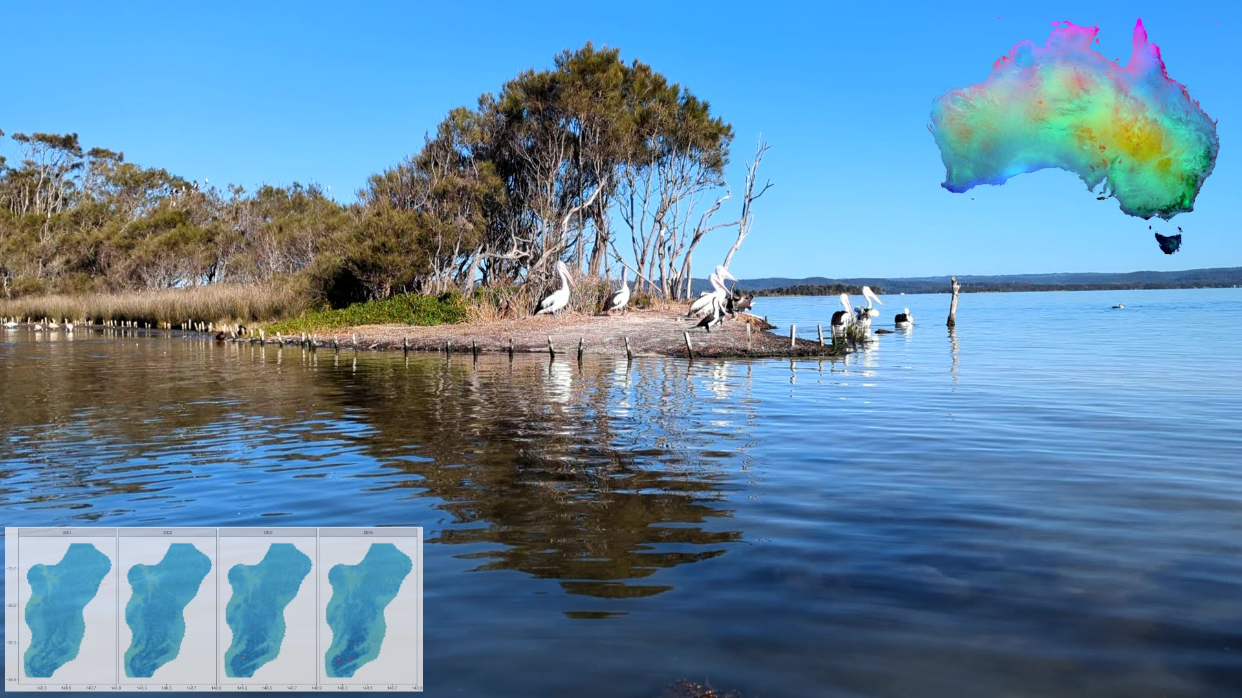

Spatio-temporal species distribution modelling

Slide 2
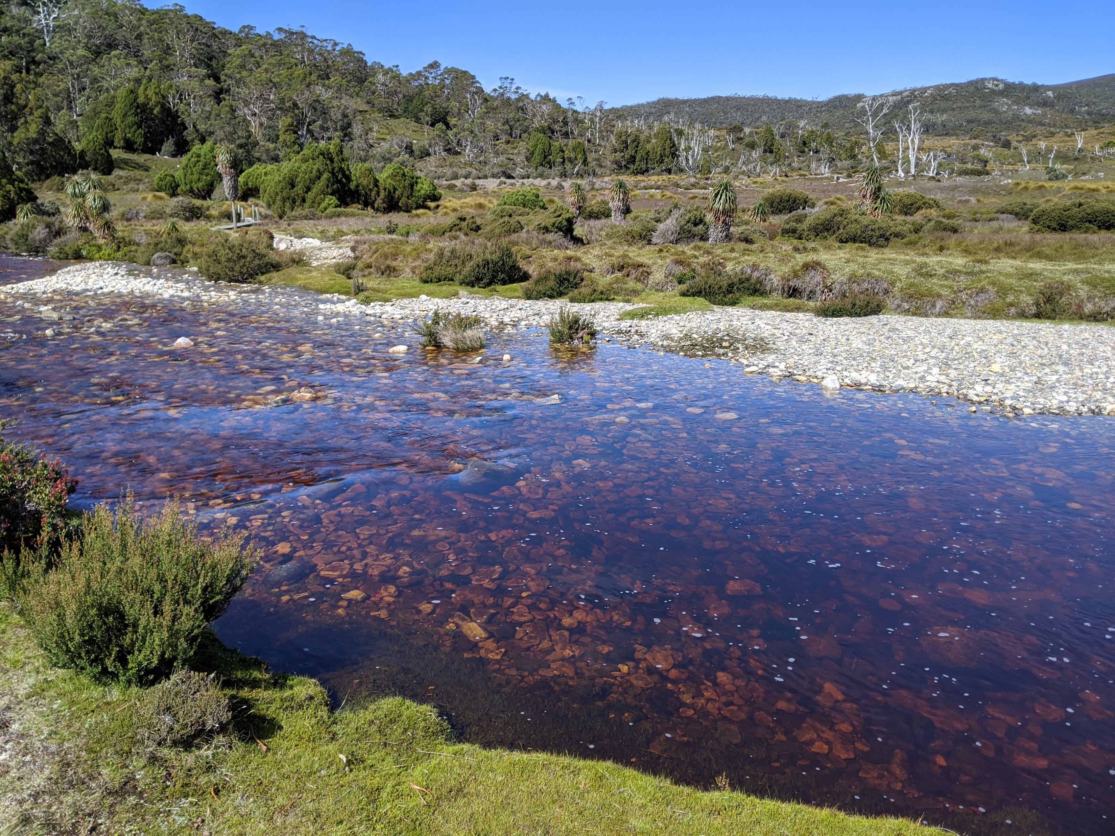
INTRODUCTION

Slide 3

So - this is me (at the start of the year…)
Sam Mason
First year PhD candidate at UNSW
Came in from 20+ years in industry
Computer/data scientist & statistician

Slide 4
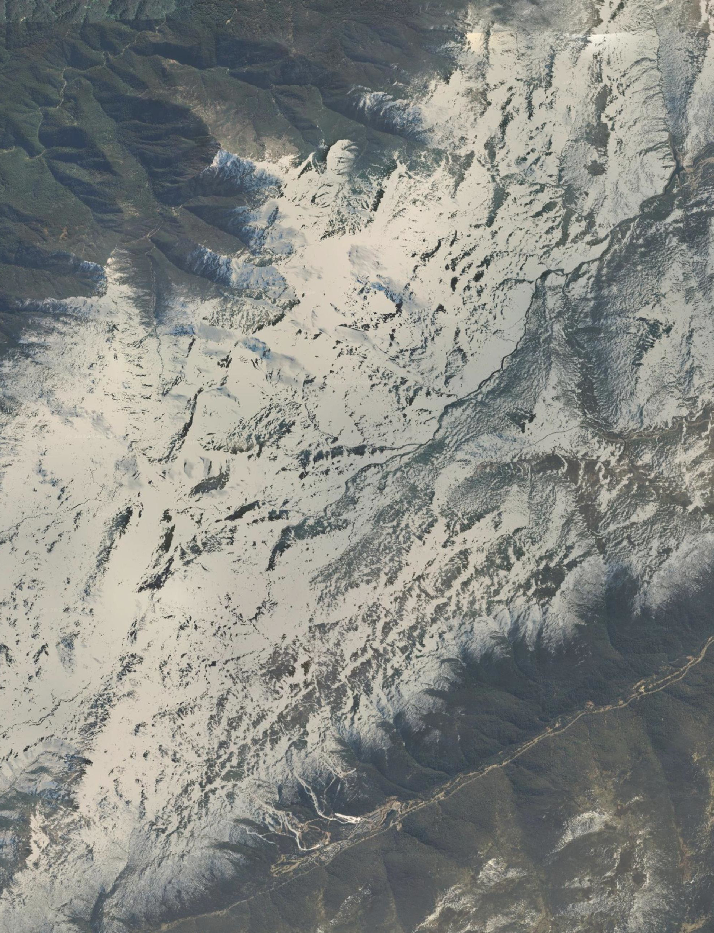
Core Thesis Aim
To detect species response to climate change using dynamic predictors and anomalies from their mean values

Slide 5
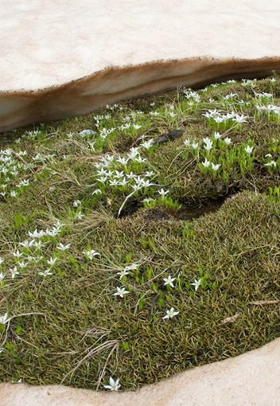
Psychrophila introloba
The Alpine Marsh-Marigold is a small herb commonly found in Australian alpine regions
Flowers at high elevations in meltwaters at edge of receding snow drifts
Restricted range (NSW into Victoria)
Hypothesis is a contraction in altitude/latitude due to environmental stressors

Slide 6
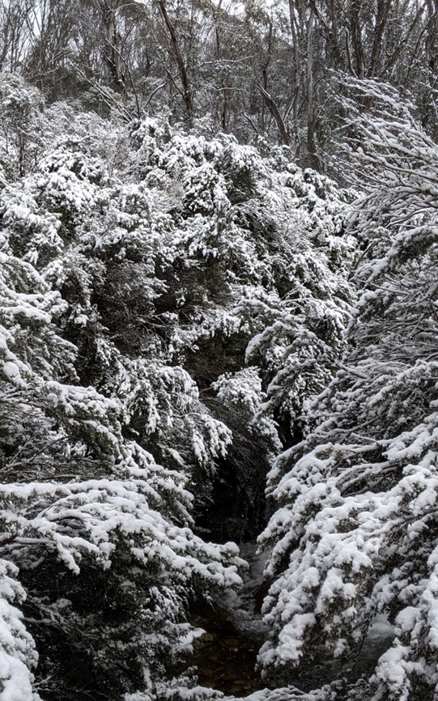
Alpine summits
Form a natural laboratory for ecological research on climate change impacts
Remote areas less impacted by human population pressures and land use activity
Species under stress can migrate to higher elevations
Or into habitats that were previously too cold

Slide 7
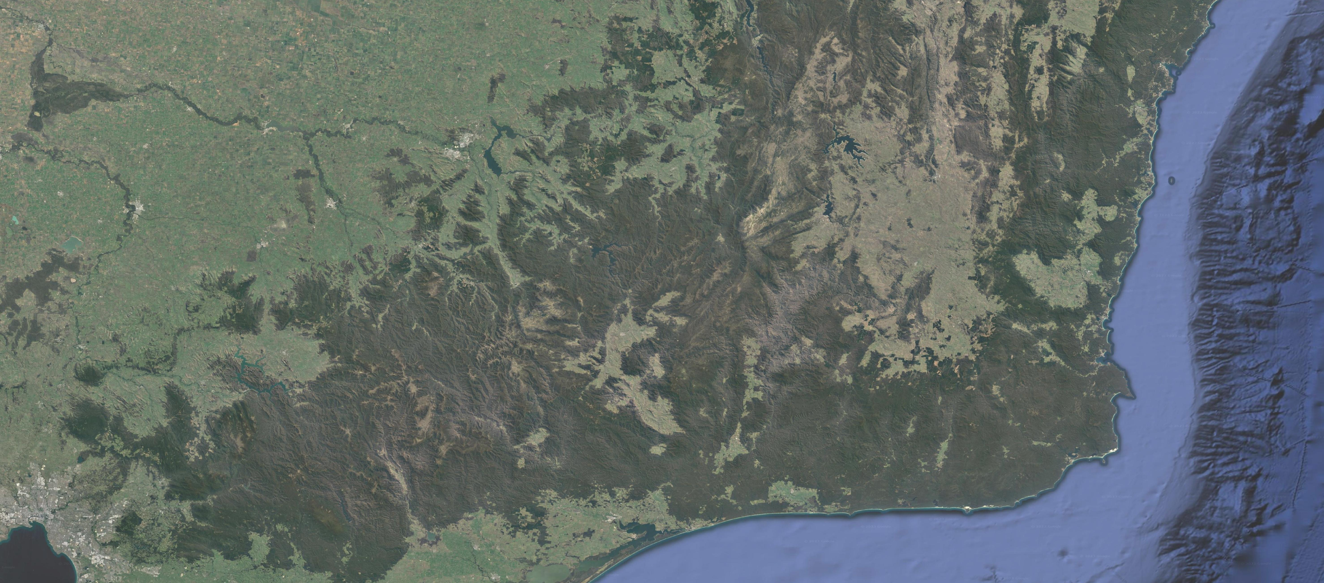

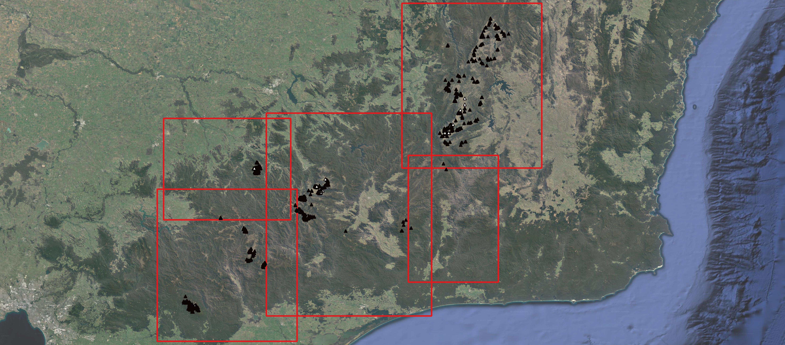
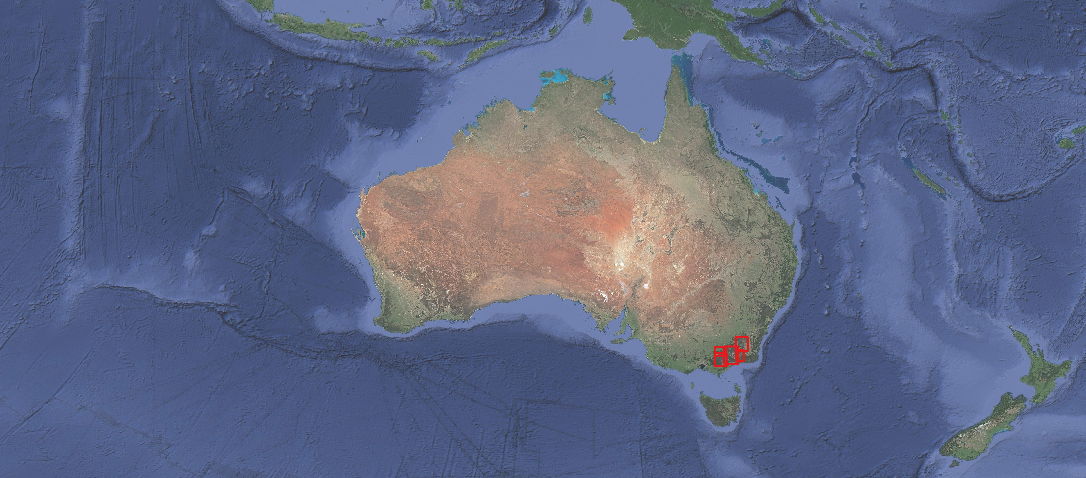
Area of Interest is ~ 63 000 km² over 45 years
Notes:
About 63K sqkm

Slide 8
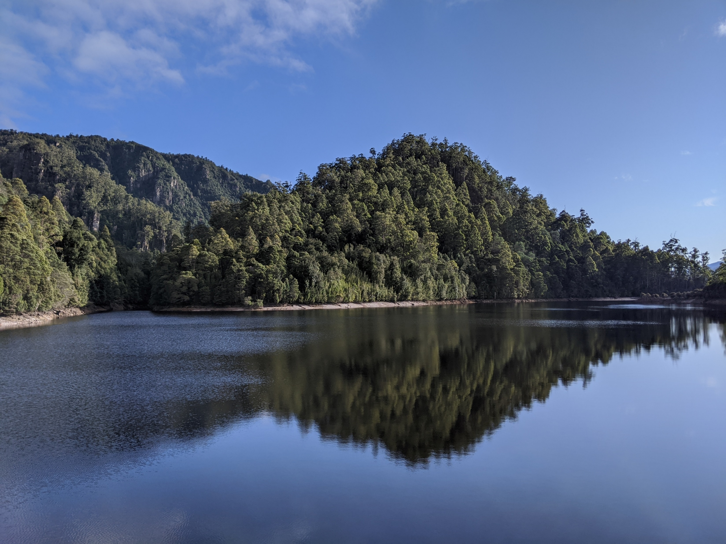
SPECIES MODELLING TODAY

Slide 9
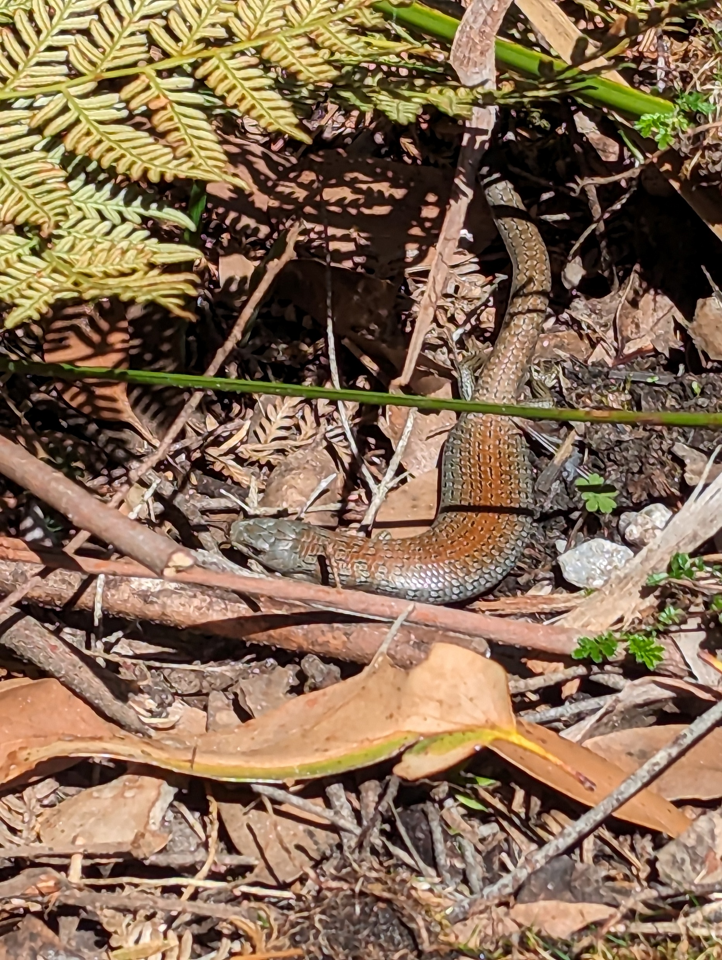
Wasting time…
Ecologists tend to use 30 year averaged bioclimatic predictors
Which masks accelerating environmental changes – particularly over the last decades
This is largely due to the relative difficulty in obtaining effective predictors at relevant spatial/temporal scales

Slide 10
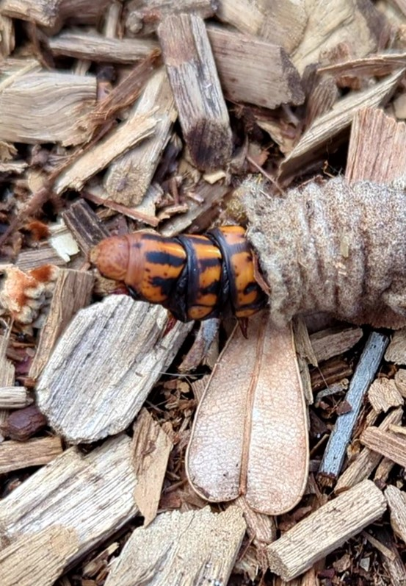
Wasting time…
Common sources are bioclim raster datasets from sites such as WorldClim, CHELSA …
But these have fixed temporal windows and are averaged over (1970-2000, 1980-2010)
Other challenges include dataset staleness, choice of variable, resolution mismatch to study area…
And also…manual downloads – no API

Slide 11
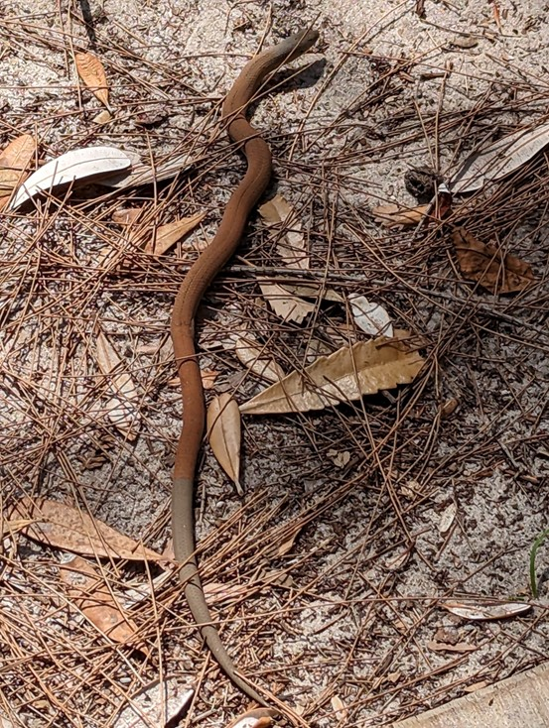
Wasting time…
Overall – it’s a challenge that requires non-trivial technical knowledge and a lot of time
BUT – if we want to look for species responses to climate change
While basically treating the climate as temporally static
That’s…not going to work…

Slide 12
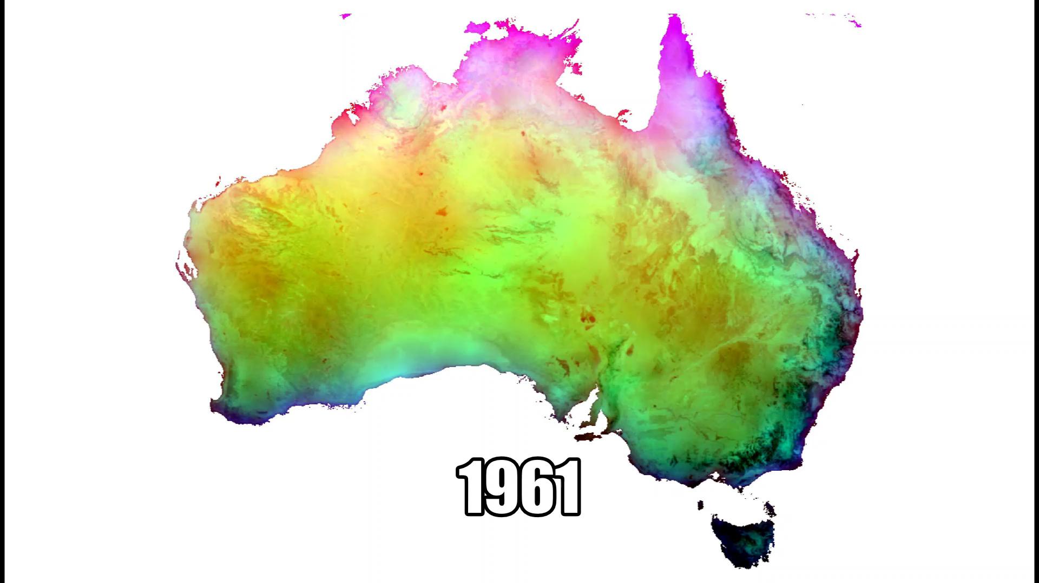
DATA ACQUISITION

Slide 13
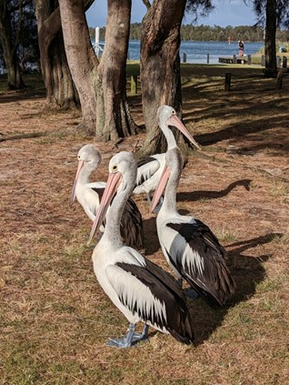
Building a species dataset
Acquiring presence-absence observations over large areas and long time periods turns out to be really hard…
National portals - TERN and ALA (PO)
And state-based sources including NSW BioNet and VBA

Slide 14
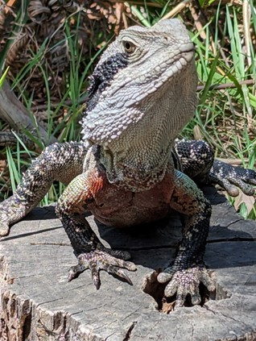
Building a species dataset
They come in many formats and usually absences have to be inferred
There’s no incentive for scientists to supply systematic survey data
Sometimes the data is there but there’s no way to export it so you have to manually assemble observations

Slide 15
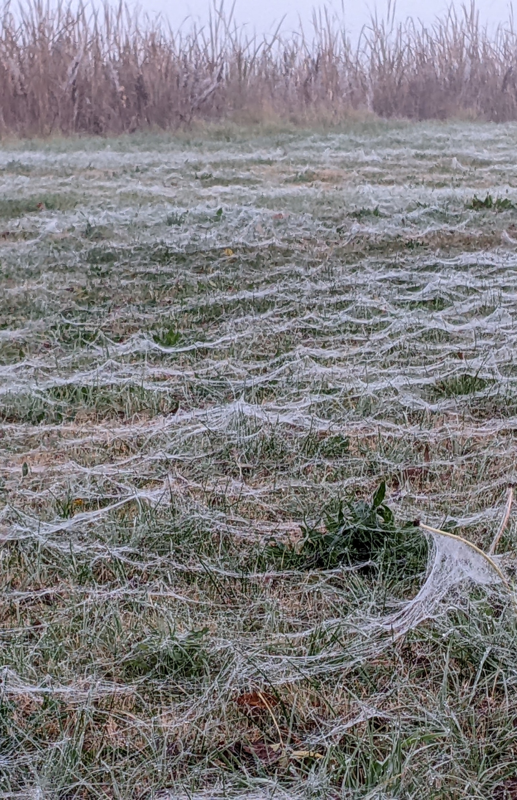
Building a species dataset
~1360 observations with about 200 recorded presences
Excludes opportunistic presences from ALA
Temporal window spans 45 years

Slide 16
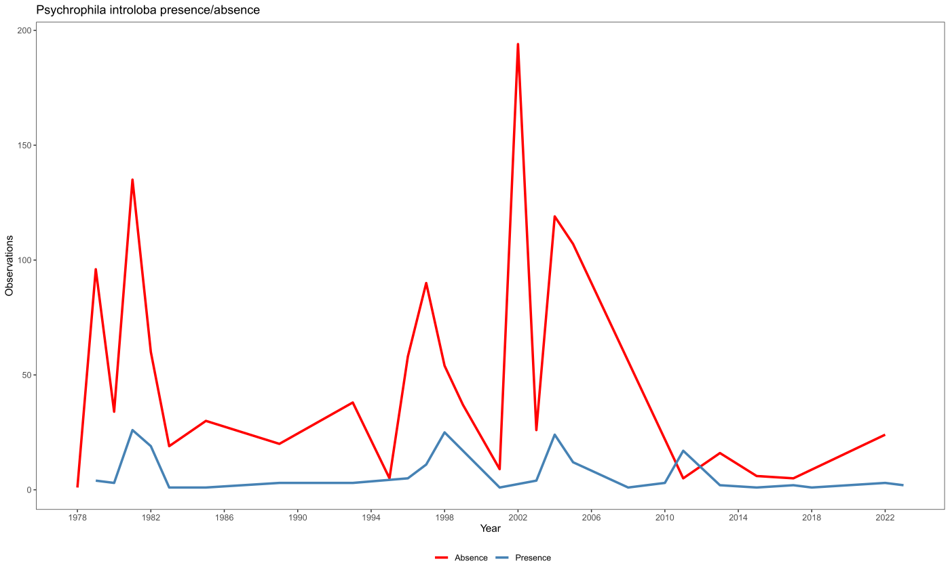

Slide 17
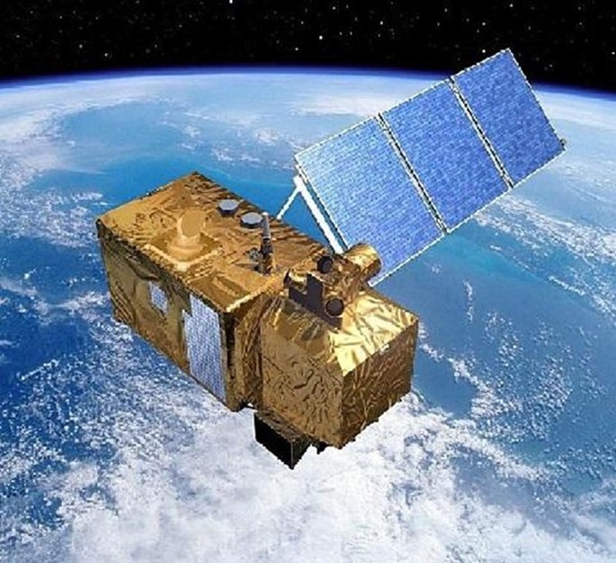
Finding predictors
The ERA5 (31 km) and ERA5-land (9 km) reanalysis products from ECMWF are currently best of breed
About 80 variables (precipitation, solar radiation, total snowfall, soil moisture…)
Available at hourly resolutions going back to 1950

Slide 18
Finding predictors
Reanalyses combine the predictions and errors of an ensemble of 10 GCMs
Available via API and a supplied python client library
As well as R packages (ecmwfr and KrigR)

Slide 19
Finding predictors
Raster datasets can be requested for specified spatial extent (ecmwfr)
And aggregated to relevant temporal scale (KrigR)
And so, the question becomes what do we choose rather than what can we get?

Slide 20
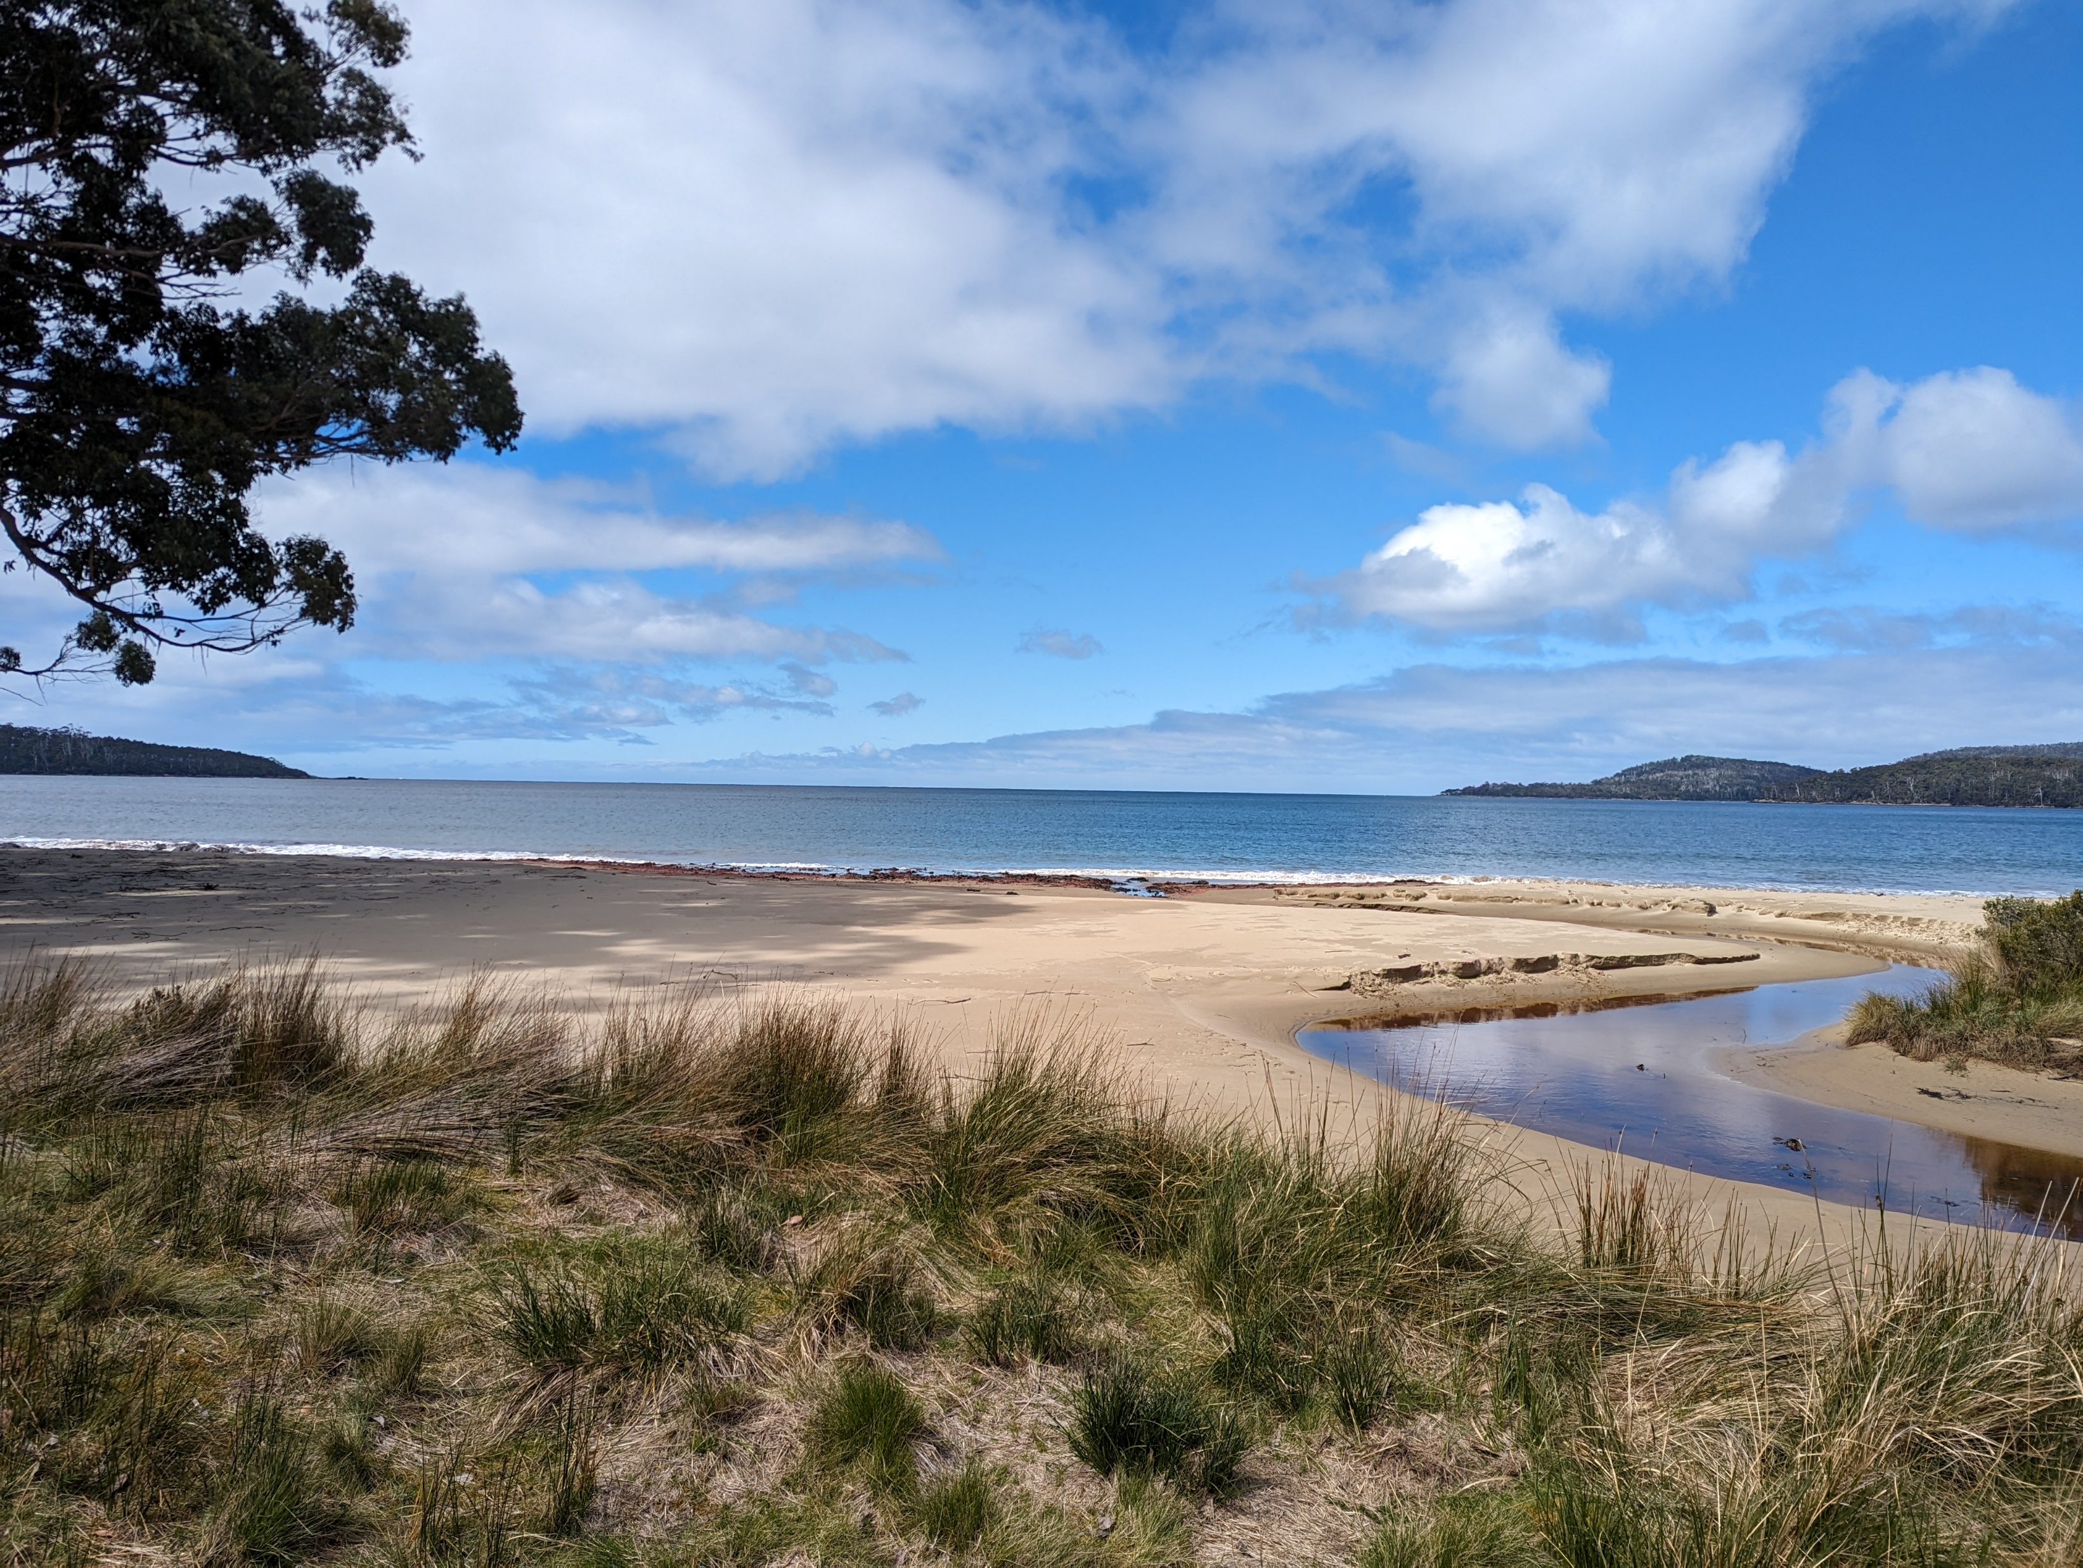
CLIMATE VARIABLES

Slide 21
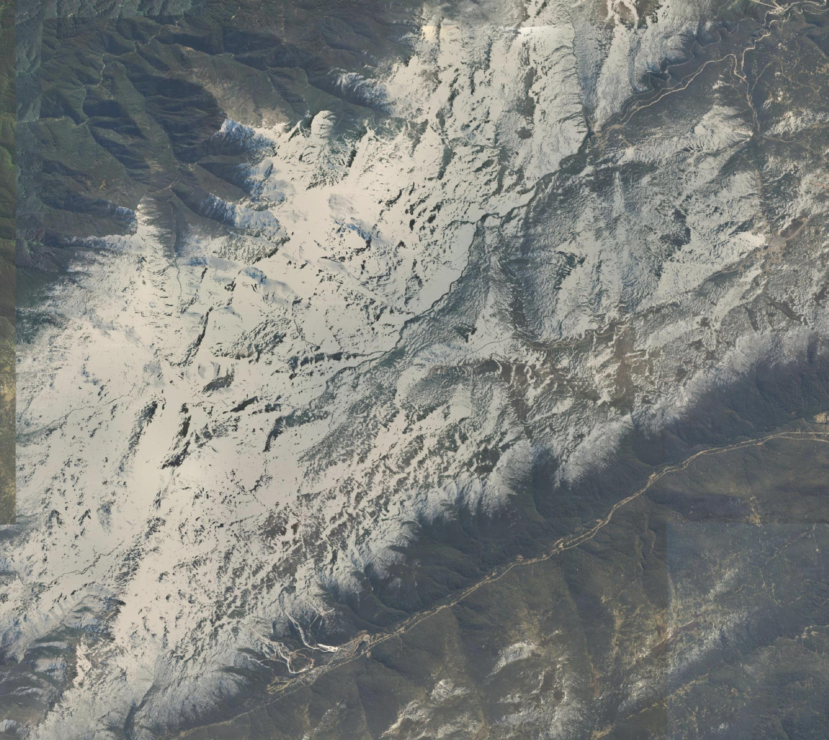
One resolution to rule them all
For many studies a raster cell resolution of 9km is still too big
So we need a way to downscale climate variables taking into account relevant physics
This is easier with some climate variables (temperature) and harder with others (precipitation)

Slide 22
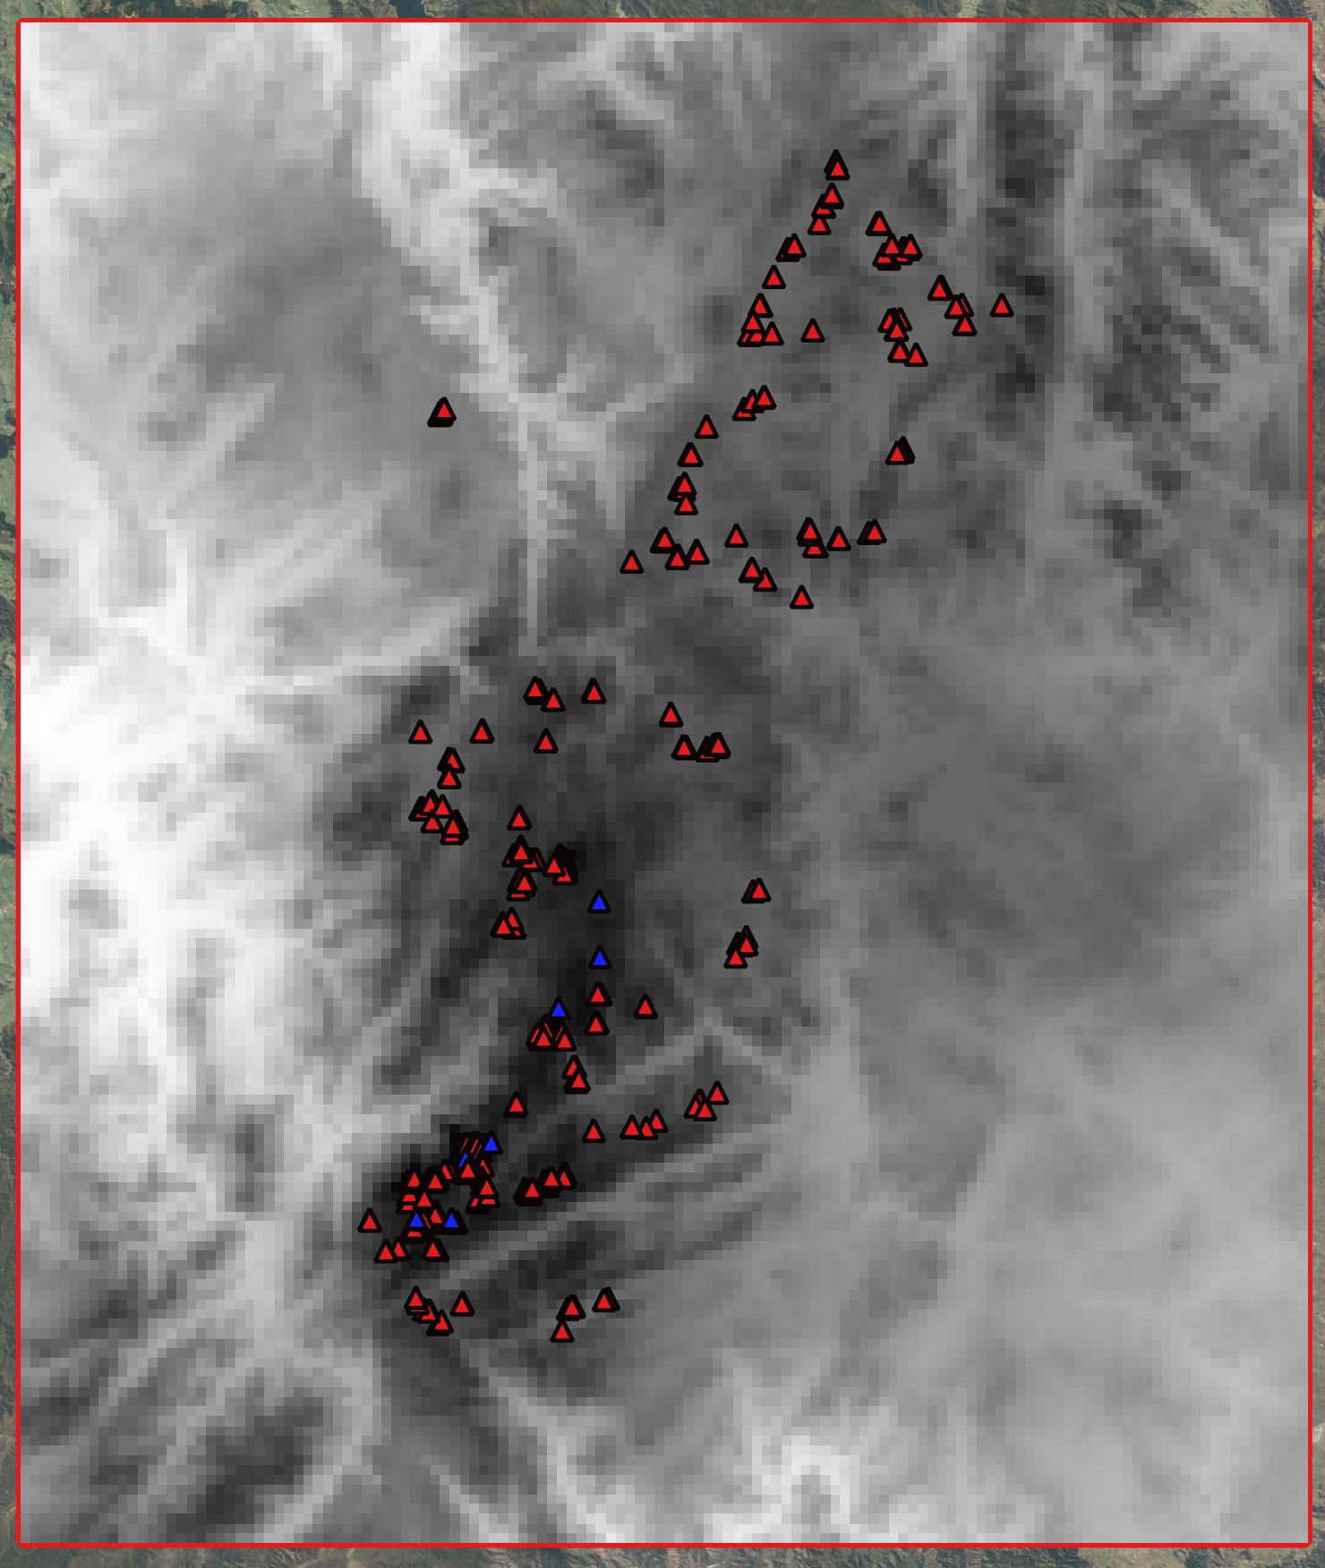
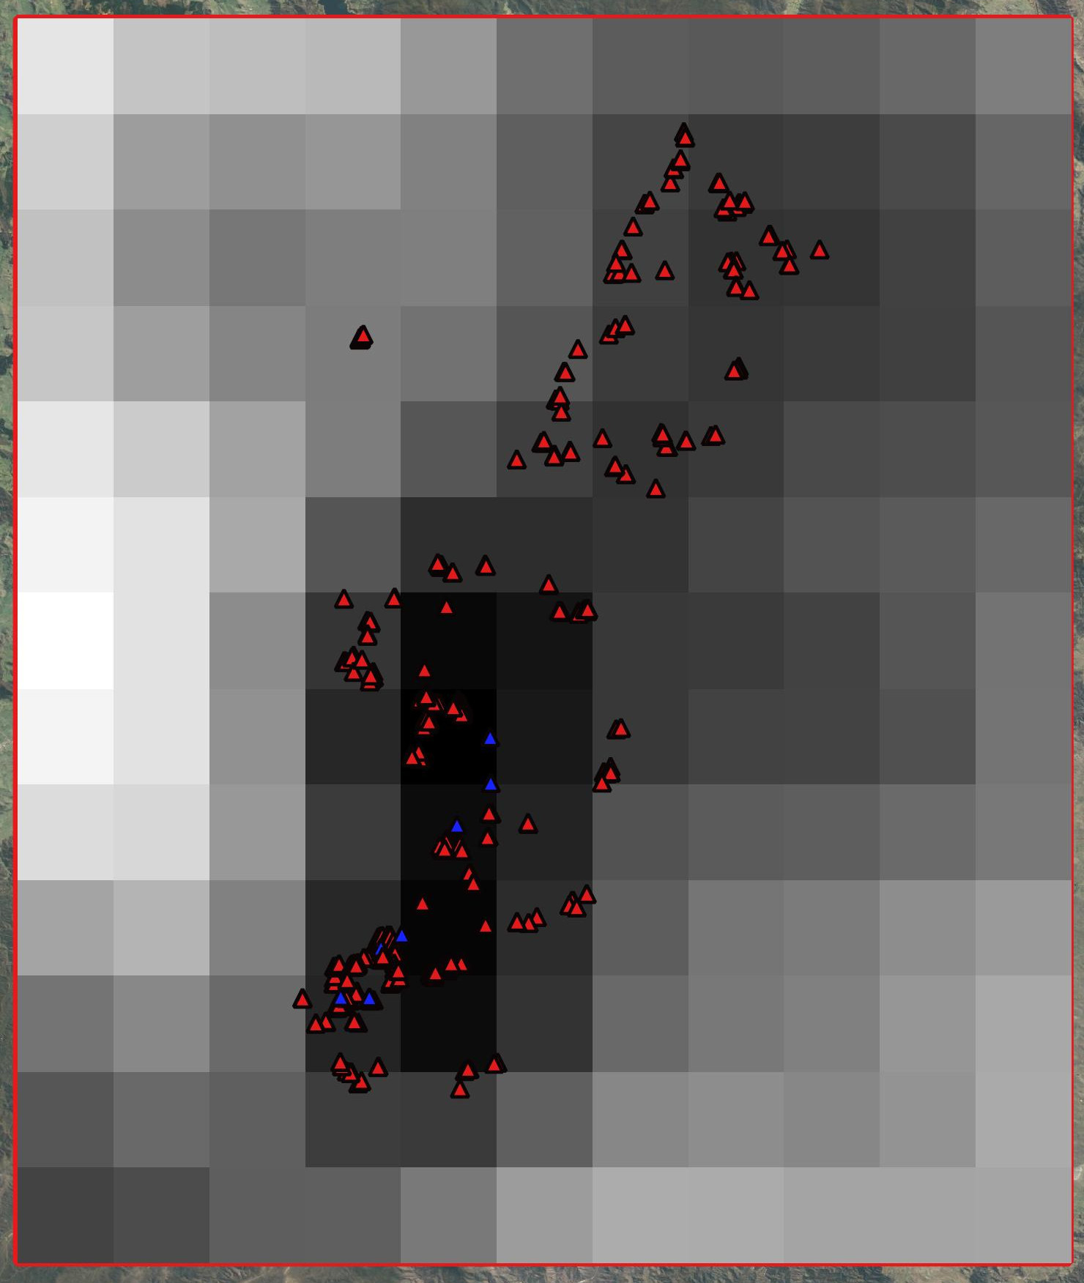
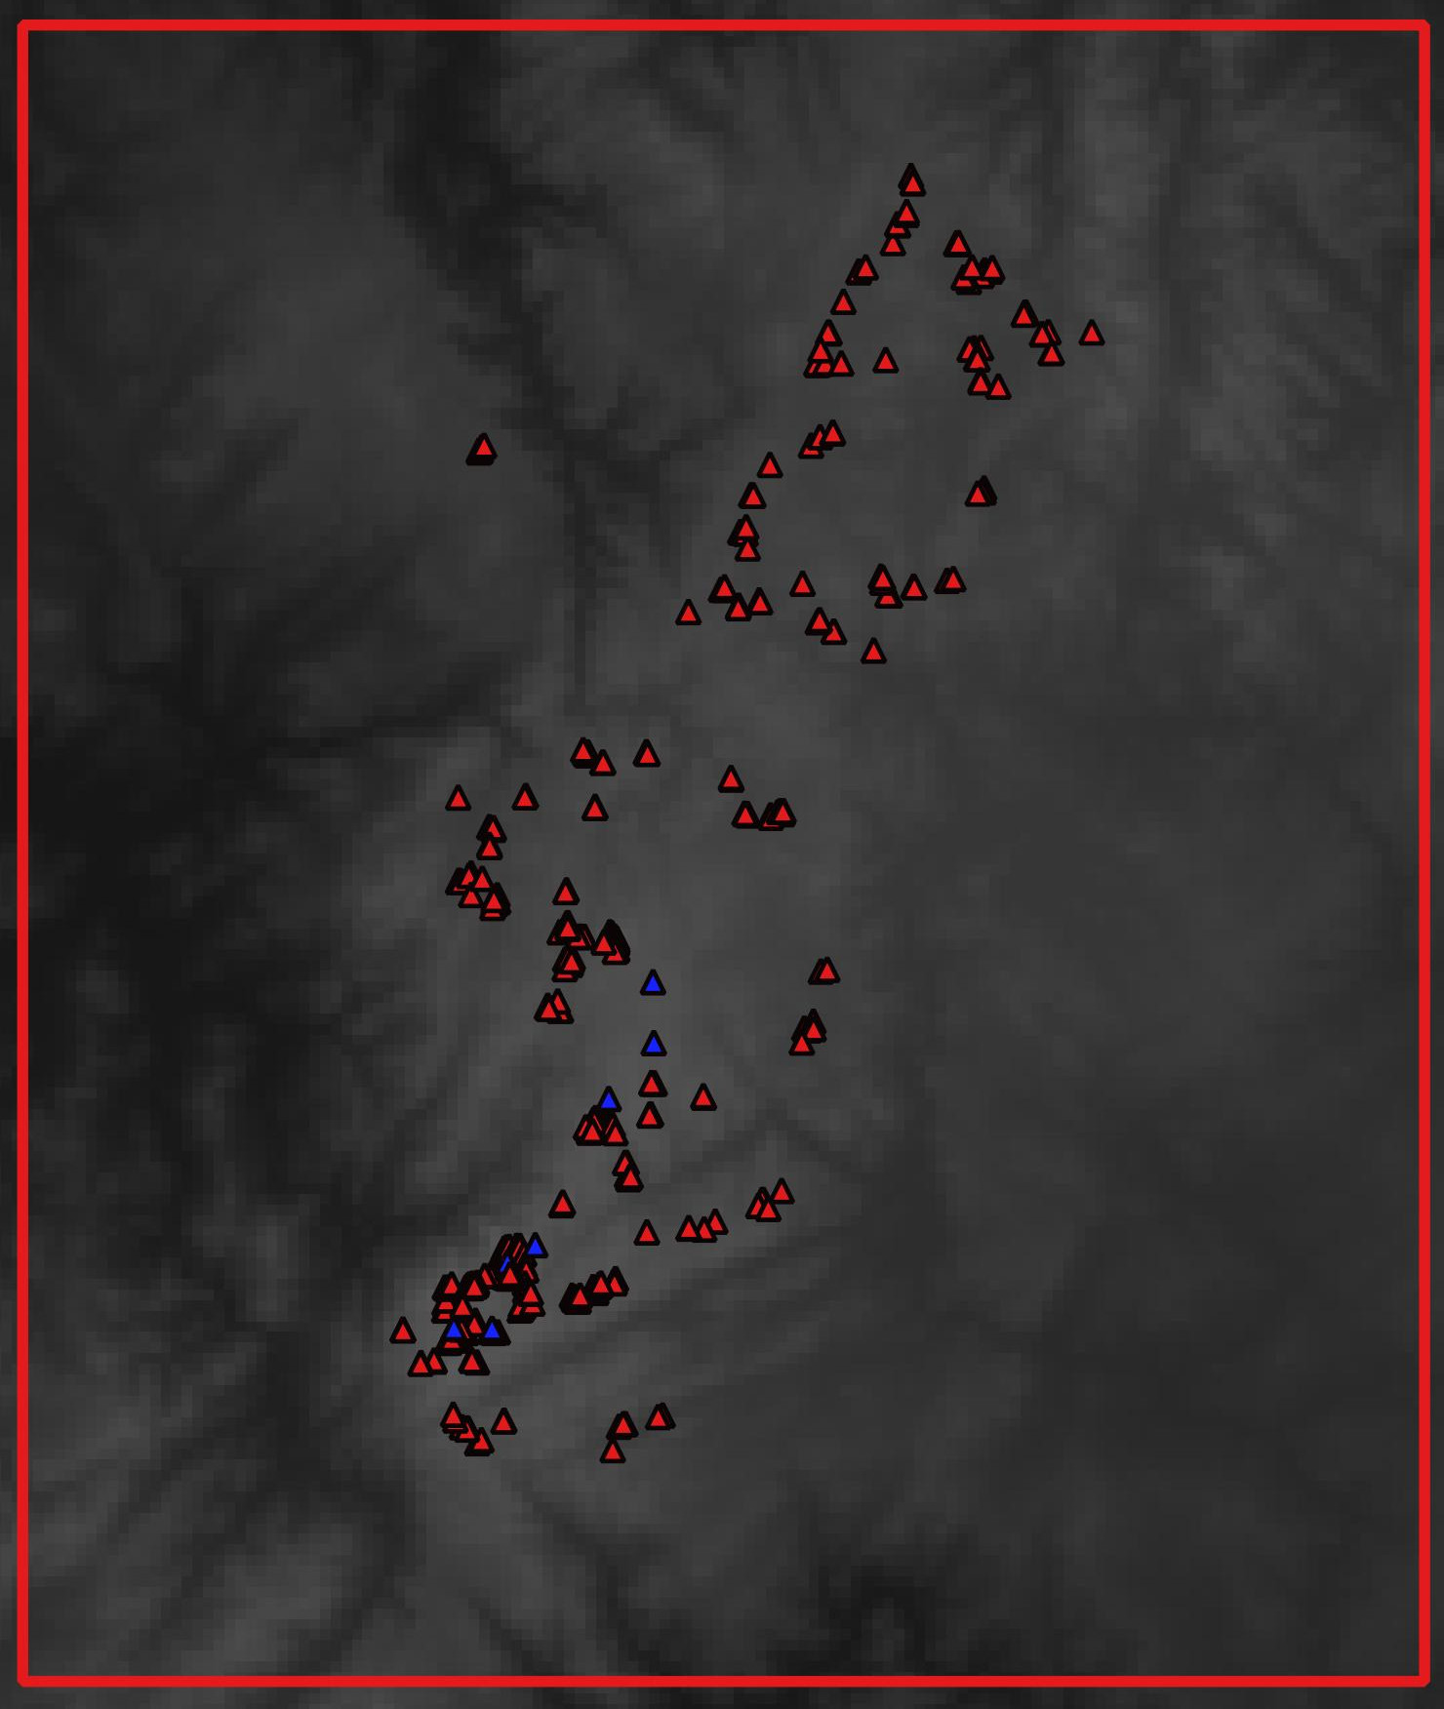
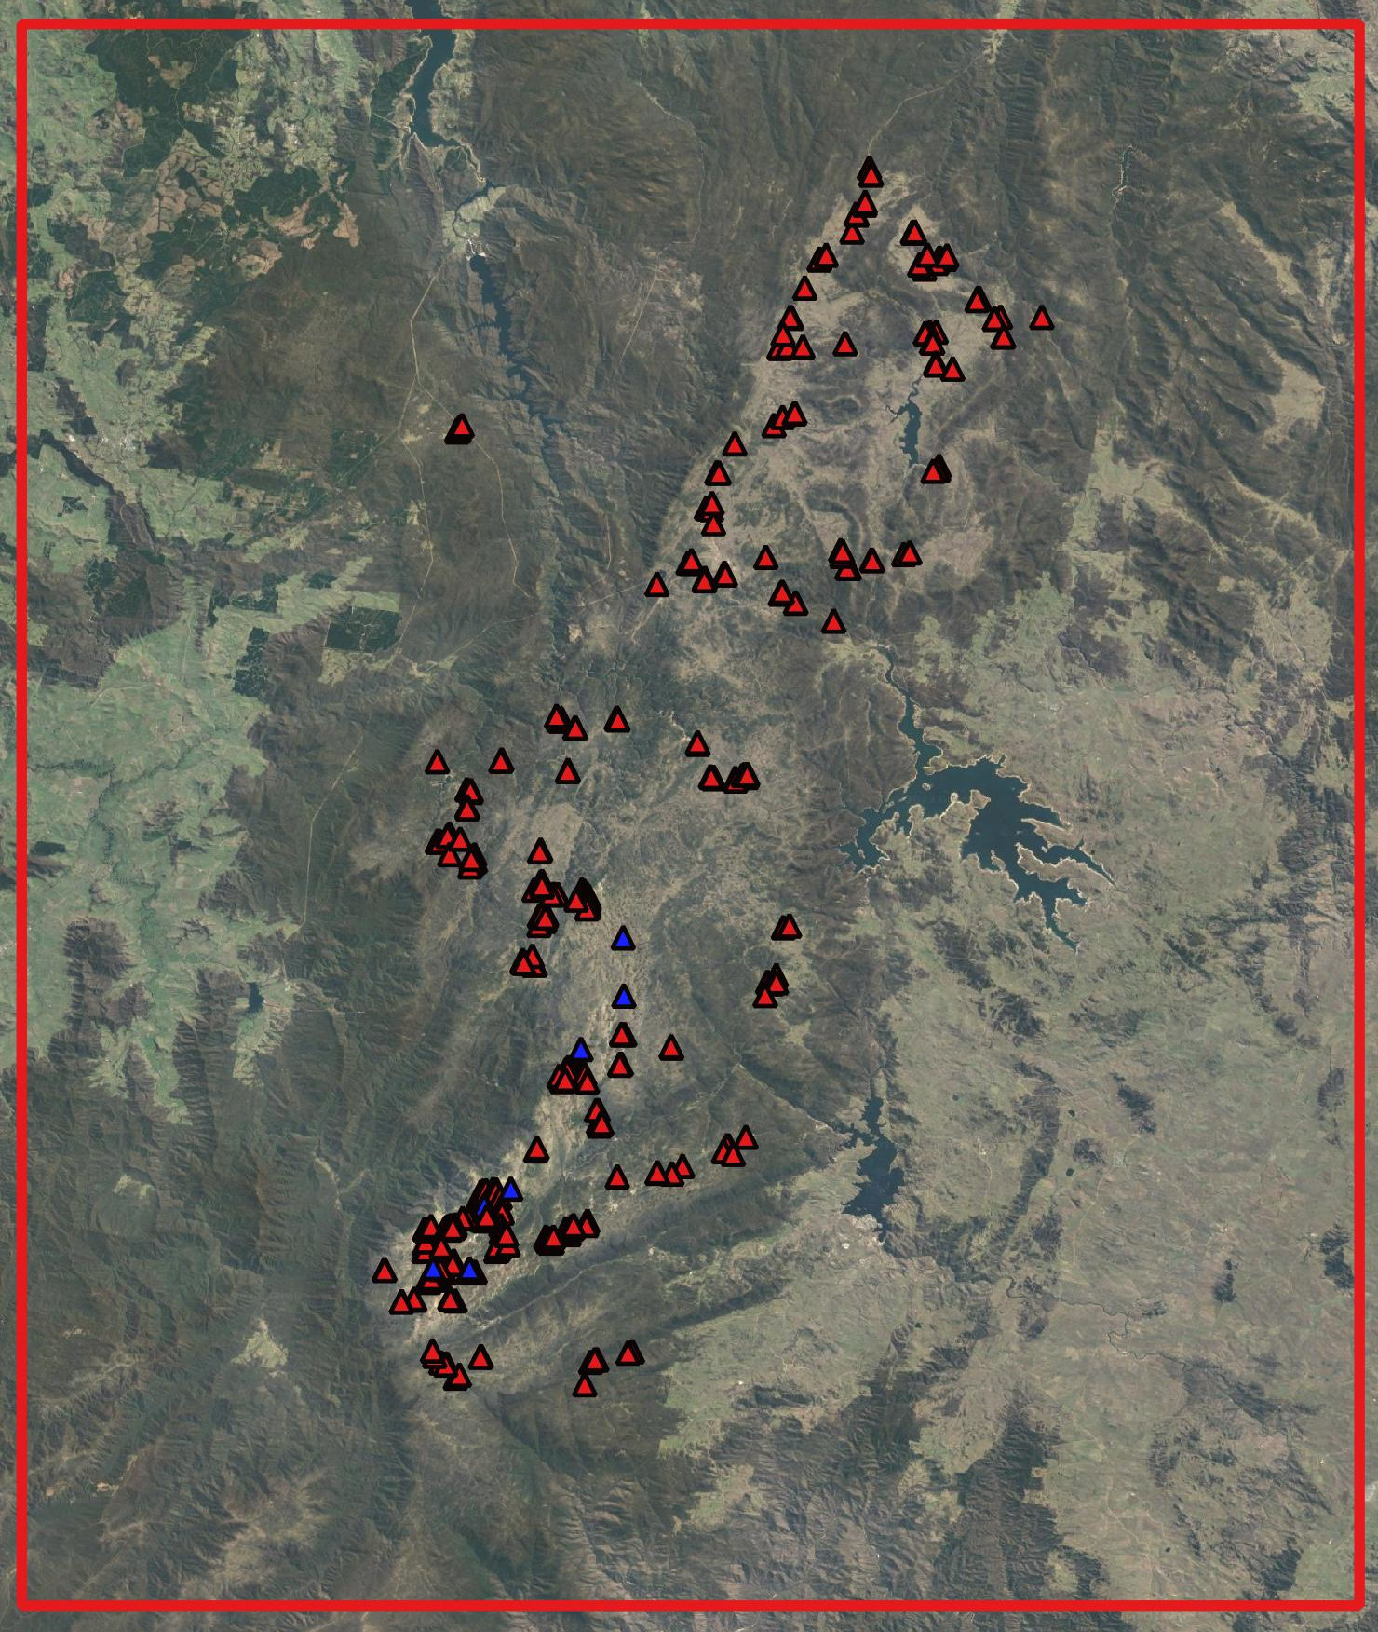
One resolution to rule them all
There are various combinations of elevation, slope, aspect as well as 7 soil property datasets
We selected our downscaling covariates under various scenarios using the 9km raster ERA5-land data
A random sample of 1/3 of the cells was kept as the hold out test set

Slide 23
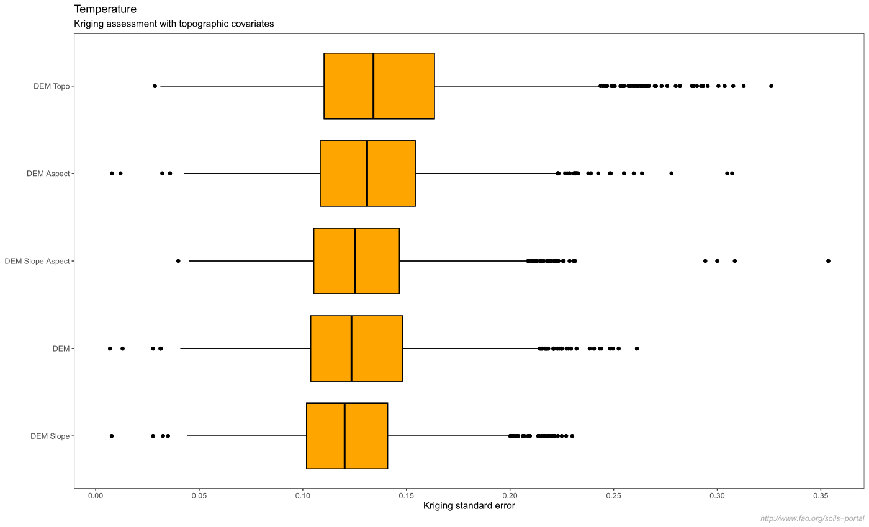

Slide 24
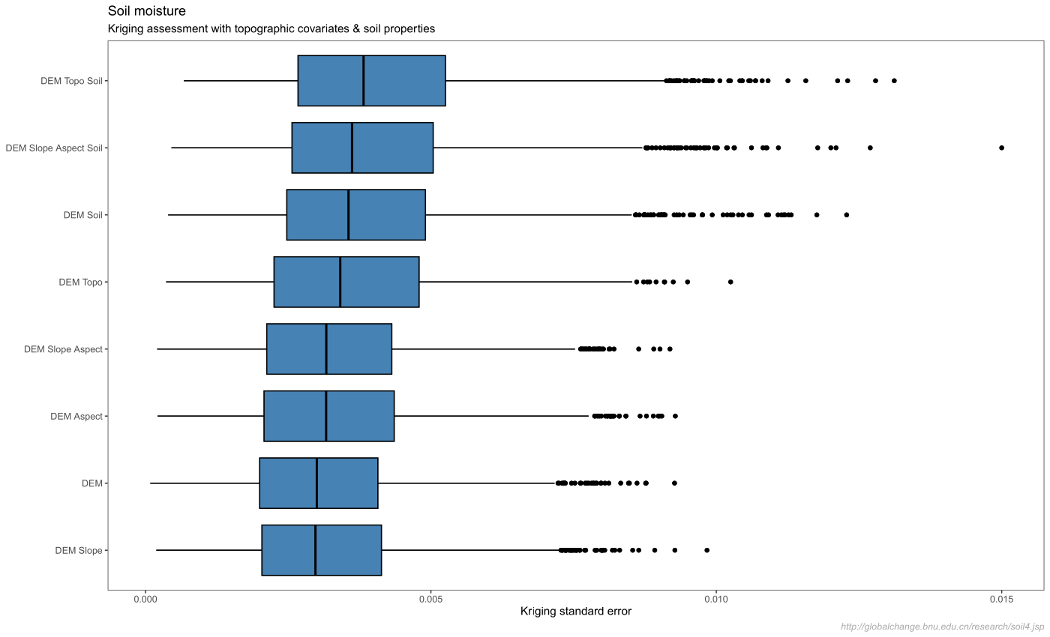

Slide 25
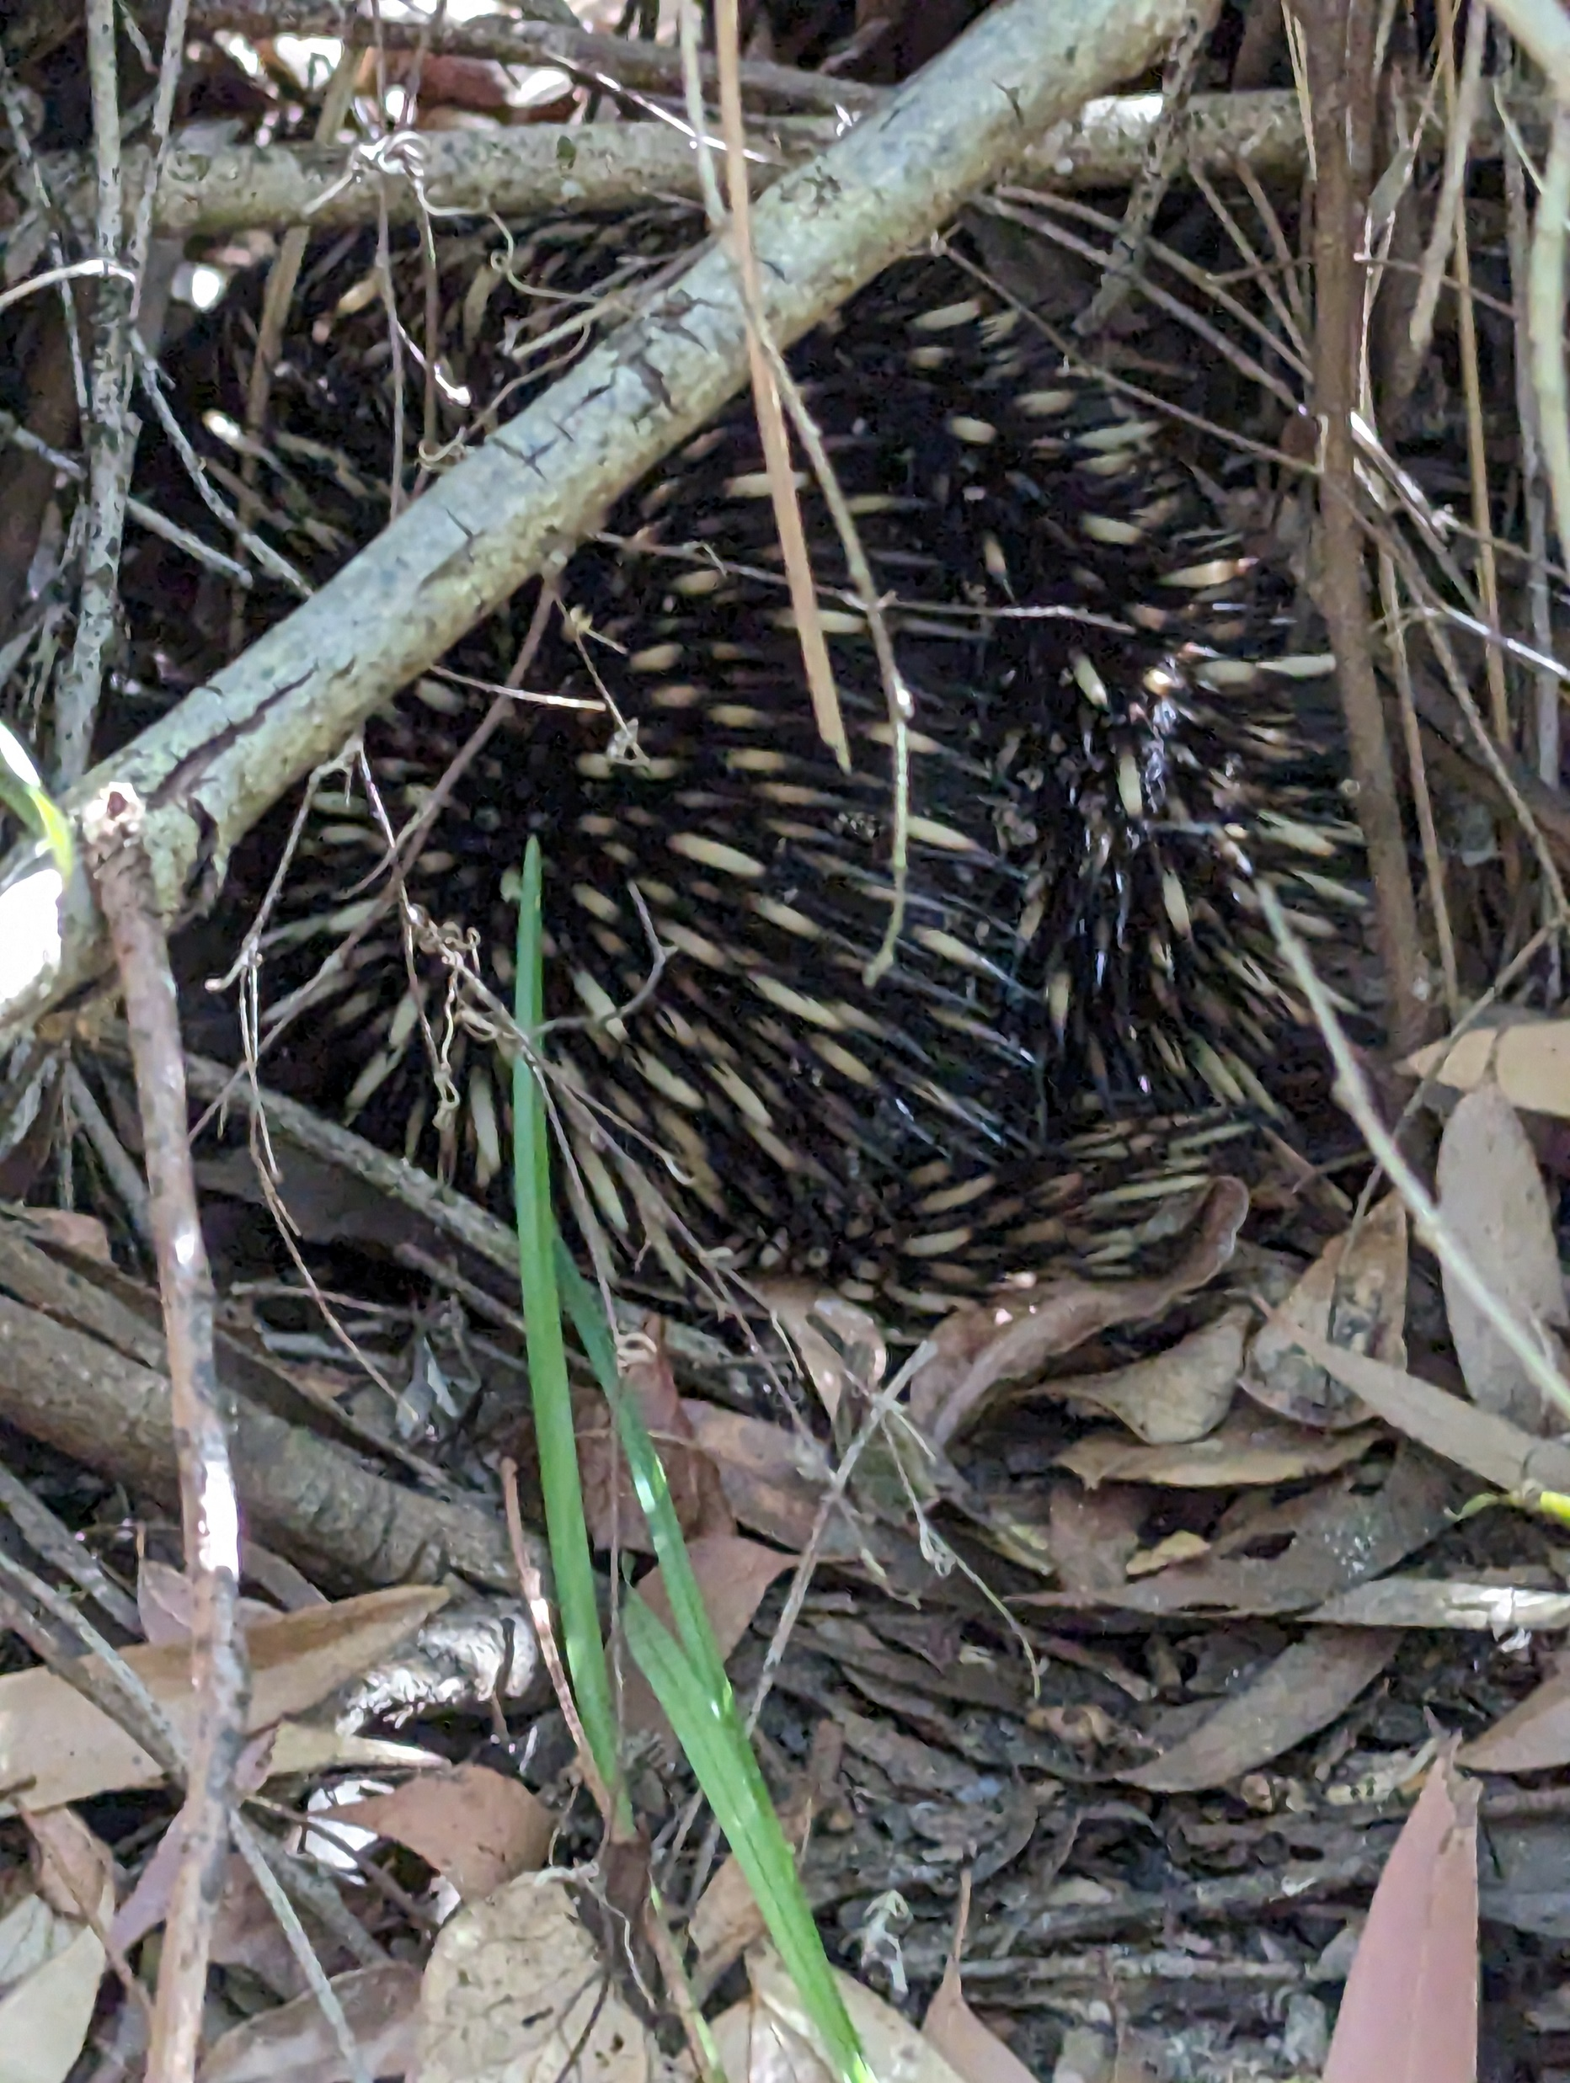
Anomalies?
We seek covariate terms that capture long term climate changes
Borrowing from climatology we can calculate deviations from long term trends
E.g. how different was the maximum temperature in given year from the overall mean max temperature across the entire study temporal window?

Slide 26
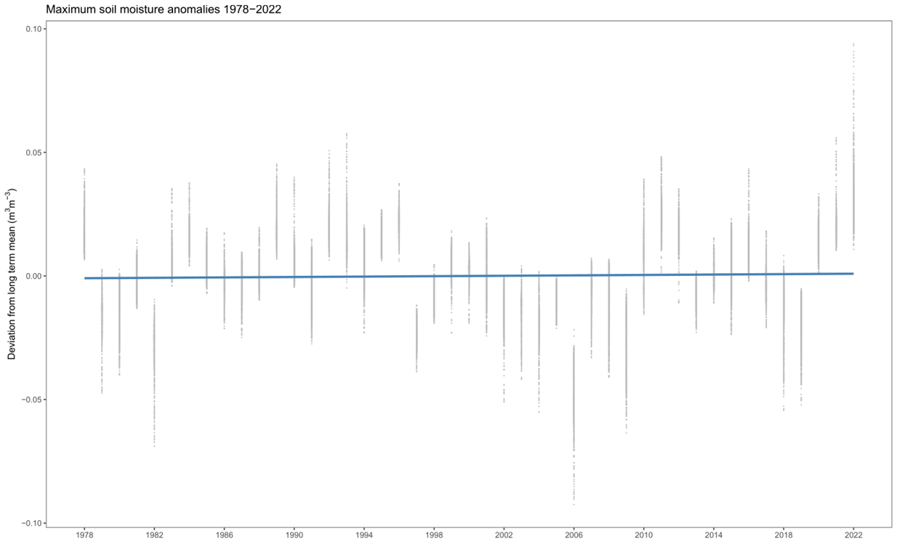
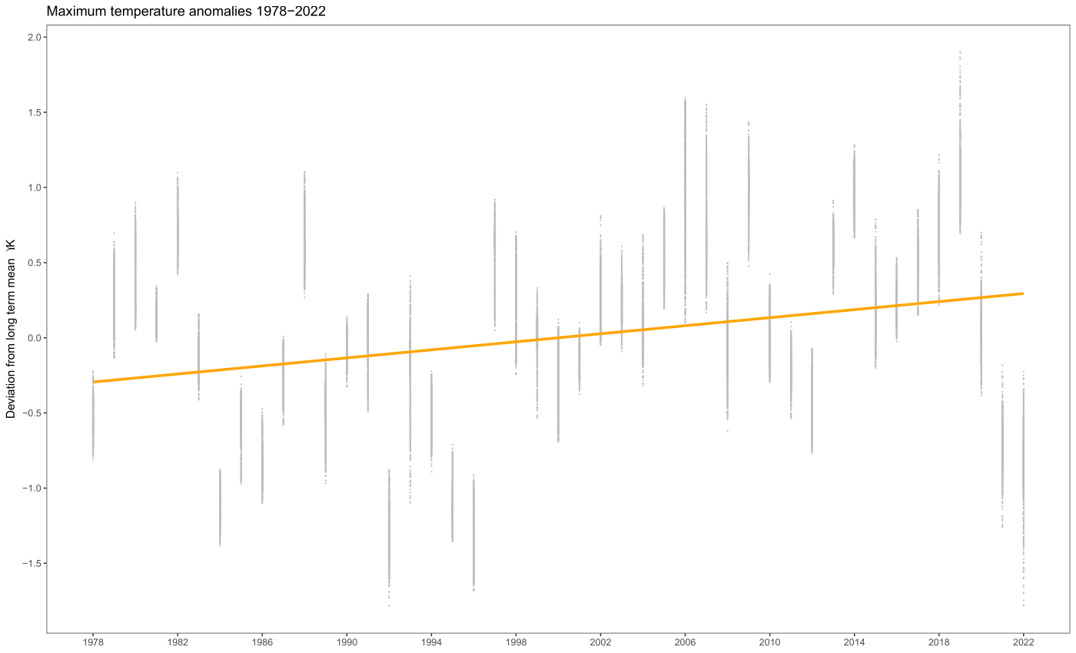
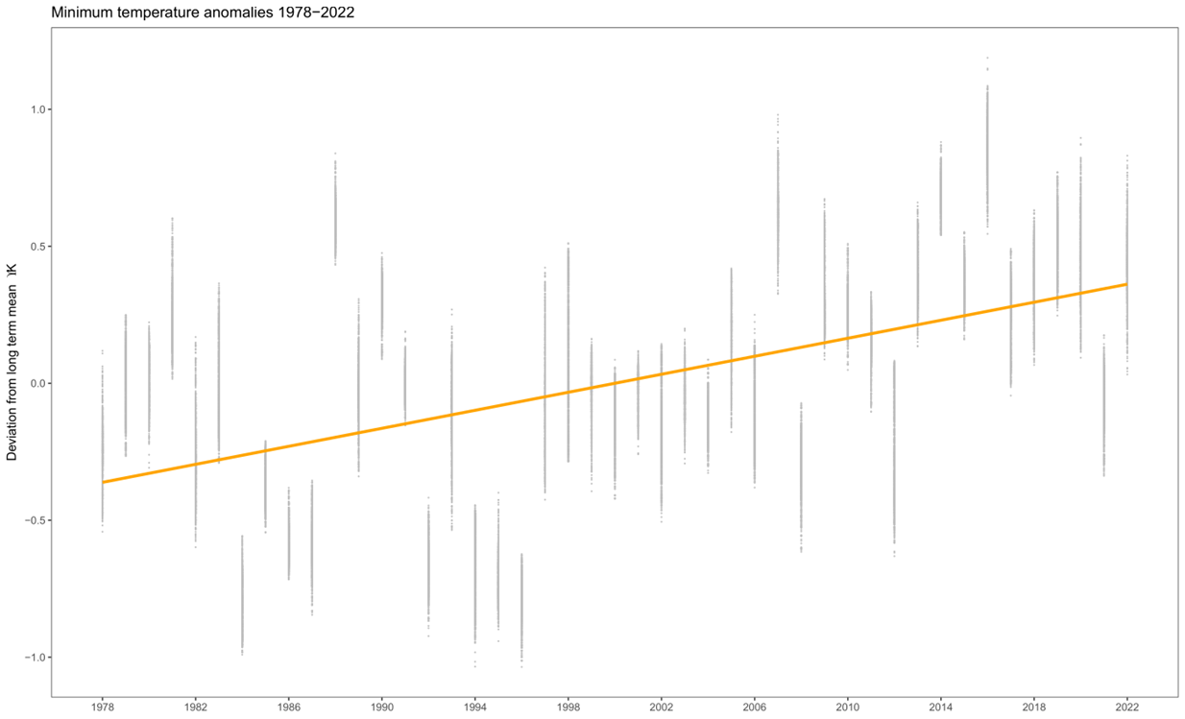
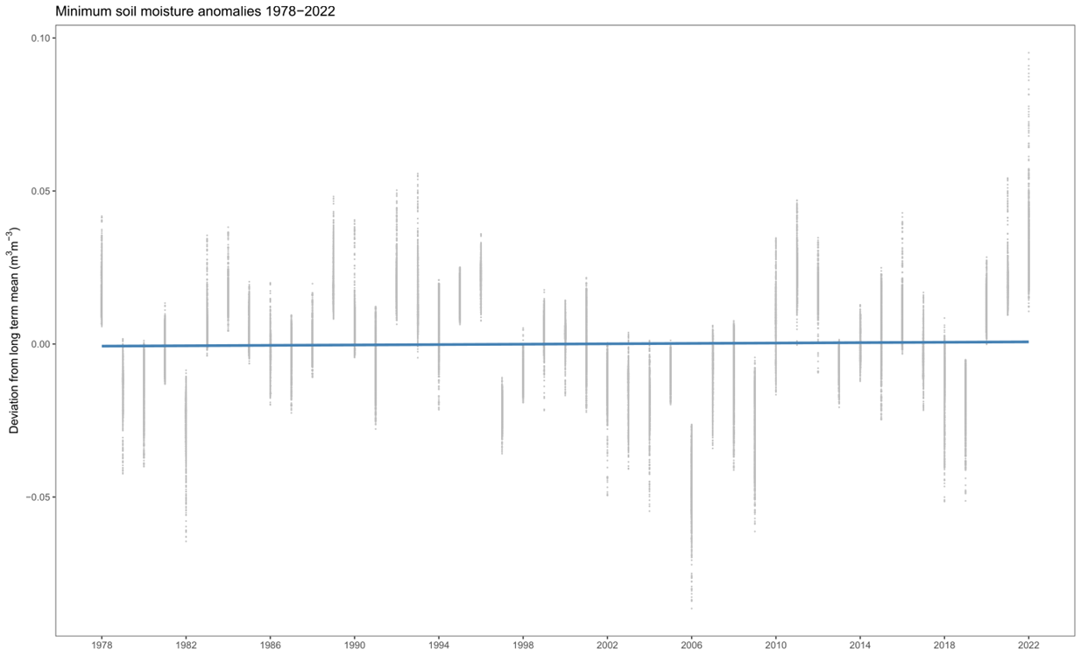

Slide 27
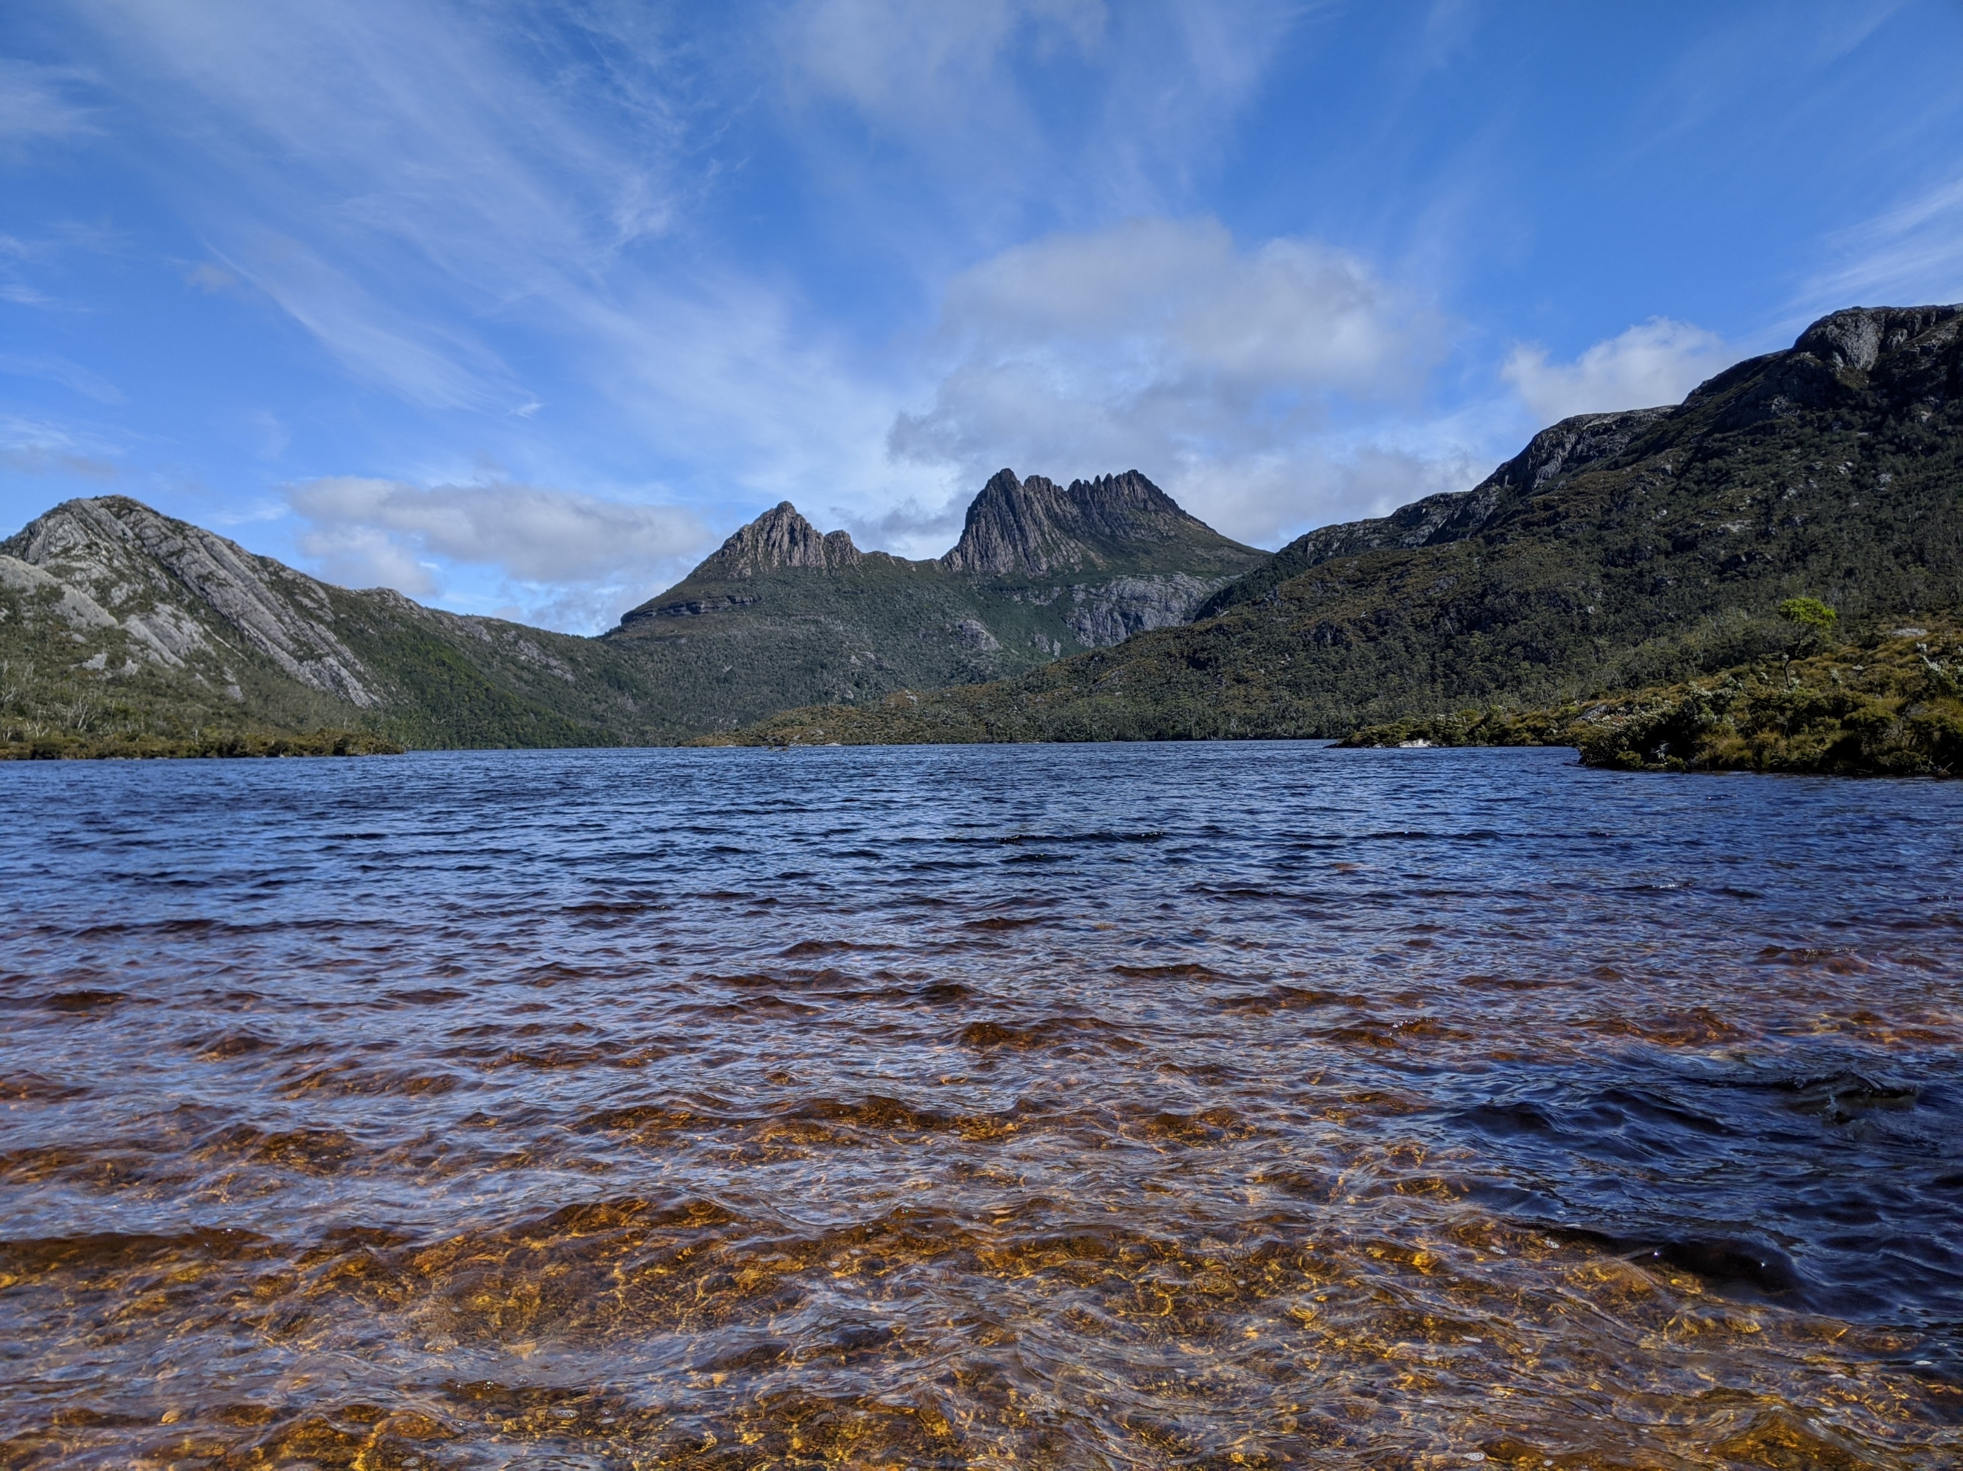
MODELLING IN SPACE & TIME

Slide 28

Model setup
Regression with a binomial response and a complementary log-log link
Space-time variables (longitude, latitude, altitude, time) not directly included - implied via spatio-temporal climate covariates
Non-linear terms included to try to capture species response to extremes

Slide 29
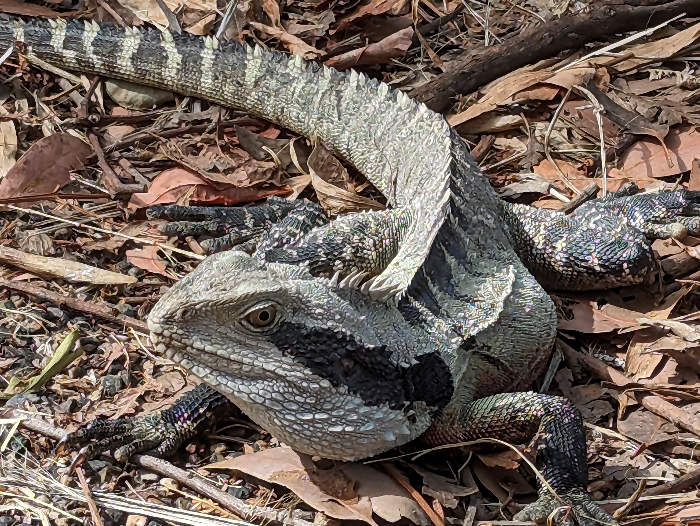
Three modelling scenarios
Fit using 30-year averaged bioclim predictors from the CHELSA GCM
Fit similar model using ERA-5 land reanalysis data averaged over the entire study window (45 years)
Still using ERA-5 data but now add anomaly values from their means

Slide 30
CHELSA model (bioclim predictors 1980-2010 means)
presence
~ temp.max (bio5 max temp warmest month)
+ temp.min (bio6 min temp coldest month)
+ water.avg (bio12 total precipitation)
+ <non-linear terms>
+ <spatial basis functions>

Slide 31
ERA5 model (predictors are 1978-2022 means)
presence
~ temp.max (mean max 2m surface temperature)
+ temp.min (mean min 2m surface temperature)
+ water.max (mean max soil moisture)
+ water.min (mean min soil moisture)
+ <non-linear terms>
+ <spatial basis functions>

Slide 32
ERA5 anomaly model (add in anomaly terms)
presence
~ temp.max + temp.min + water.max + water.min
+ temp.max.anom + temp.min.anom
+ water.max.anom + water.min.anom
+ <non-linear terms>
+ <spatial/spatio-temporal) basis functions>

Slide 33
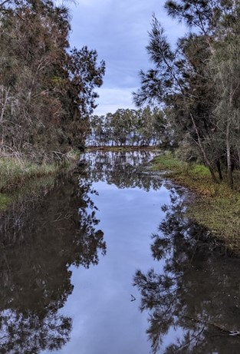
Two modelling methods
GAM with spatial smoothers
Are anomaly terms significant?
Fixed Rank Kriging with spatial & spatio-temporal basis functions
Can we answer the research question “Is the species distribution actually changing in response to climate?”

Slide 34
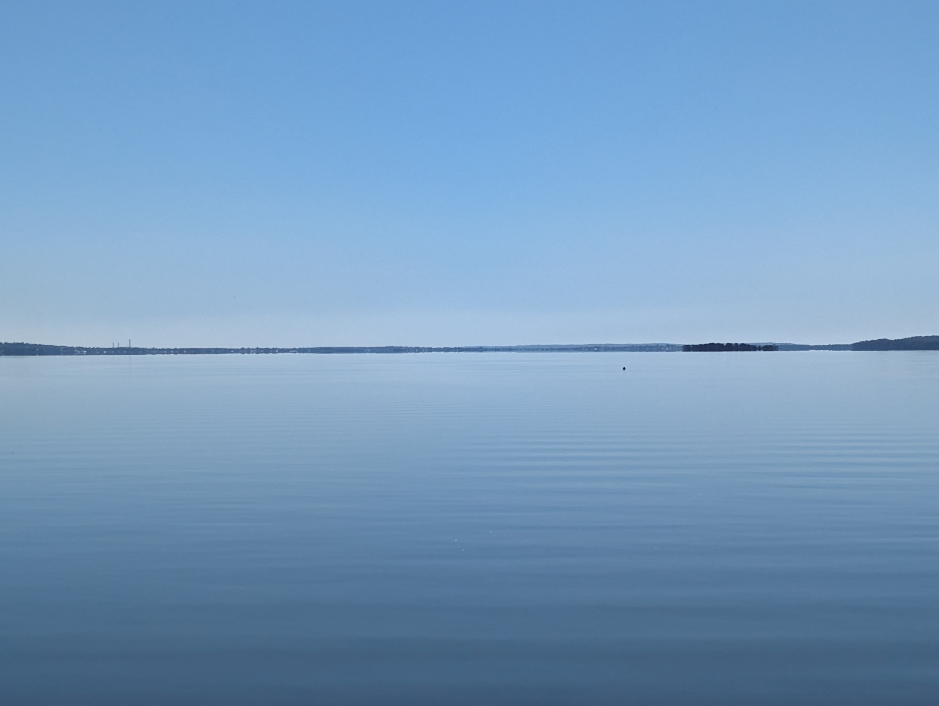
HOW DID WE GO?

Slide 35
Overall results
METHOD | MODEL | LL | BIC | NOTES
GAM | CHELSA | -375.8 | 1096.4 | k =100 knots
 | ERA 5 | -369.6 | 1104.9
 | ERA 5 Anomaly | -349.3 | 1096.3
METHOD | MODEL | LL | BIC | NOTES
FRK | CHELSA | -55.4 | 177.7 | 12 spatial basis functions
 | ERA 5 | -55.8 | 190.7
 | ERA 5 Anomaly | -161.2 | 454.9
 | ERA 5 Anomaly | -129.1 | 403.4 | 12 spatial basis functions + 5 temporal basis functions with 5-year apertures

Slide 36
Estimates
 | GAM | FRK
Intercept | -11.49 | -10.66
temp.max | -0.42 | -9.55
temp.max.sq | 2.87 | -1.78
temp.min | -13.35 | 5.91
temp.min.sq | -4.59 | 1.50
water.max | -72.40 | -31.09
water.max.sq | 16.74 | 11.76
water.min | 54.47 | 23.56
water.min.sq | -13.34 | -9.20
 | GAM | FRK
temp.max.anom | 4.19 | 6.56
temp.max.anom.sq | -3.34 | -3.44
temp.min.anom | -3.29 | -2.91
temp.min.anom.sq | 5.69 | 8.04
water.max.anom | 14.34 | 21.96
water.max.anom.sq | -5.26 | 1.62
water.min.anom | -14.63 | -21.84
water.min.anom.sq | 7.05 | -0.85

Slide 37
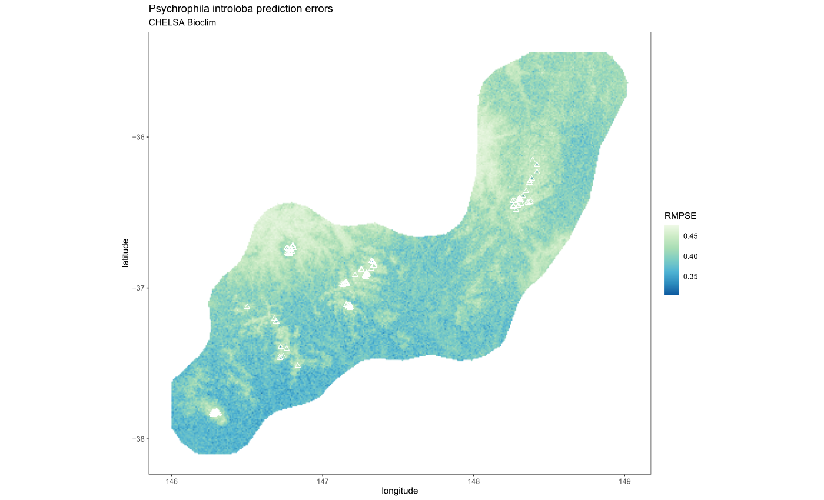

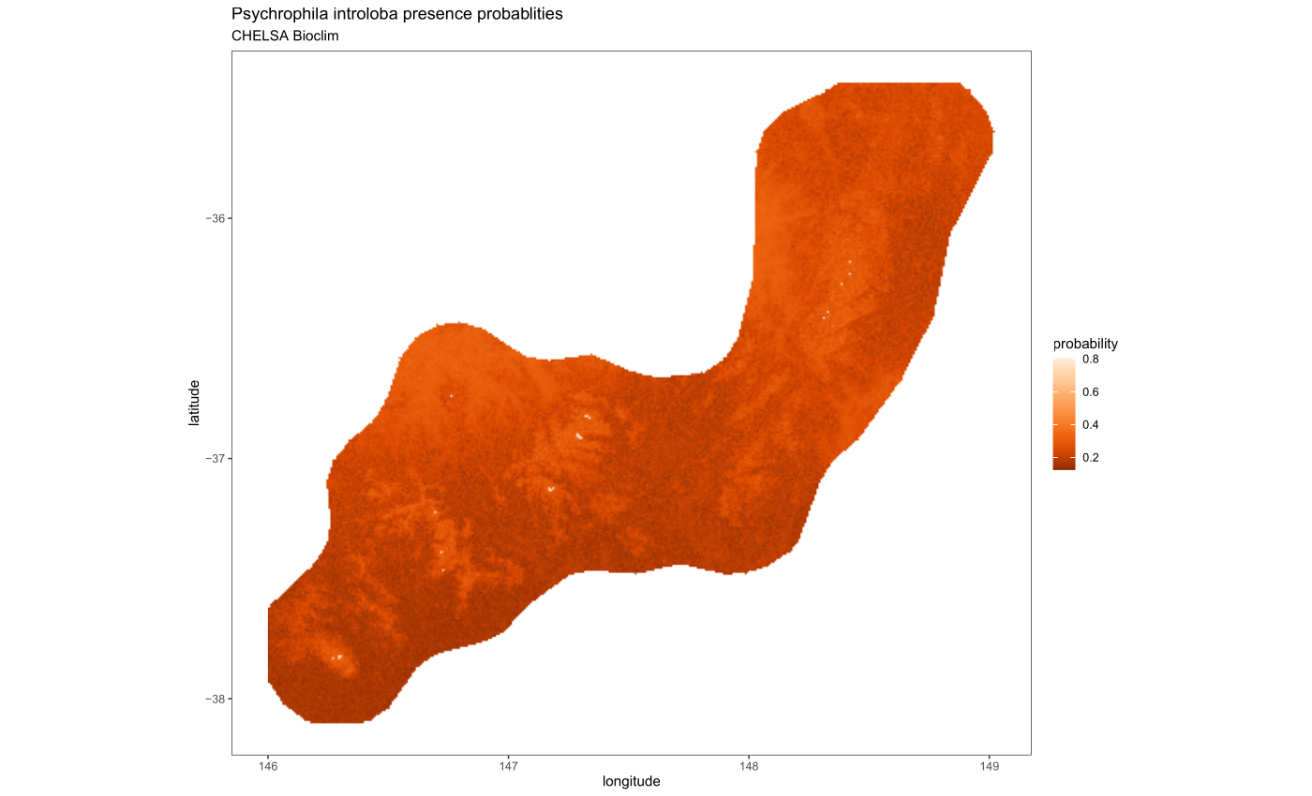

BIC : 177.7

Slide 38
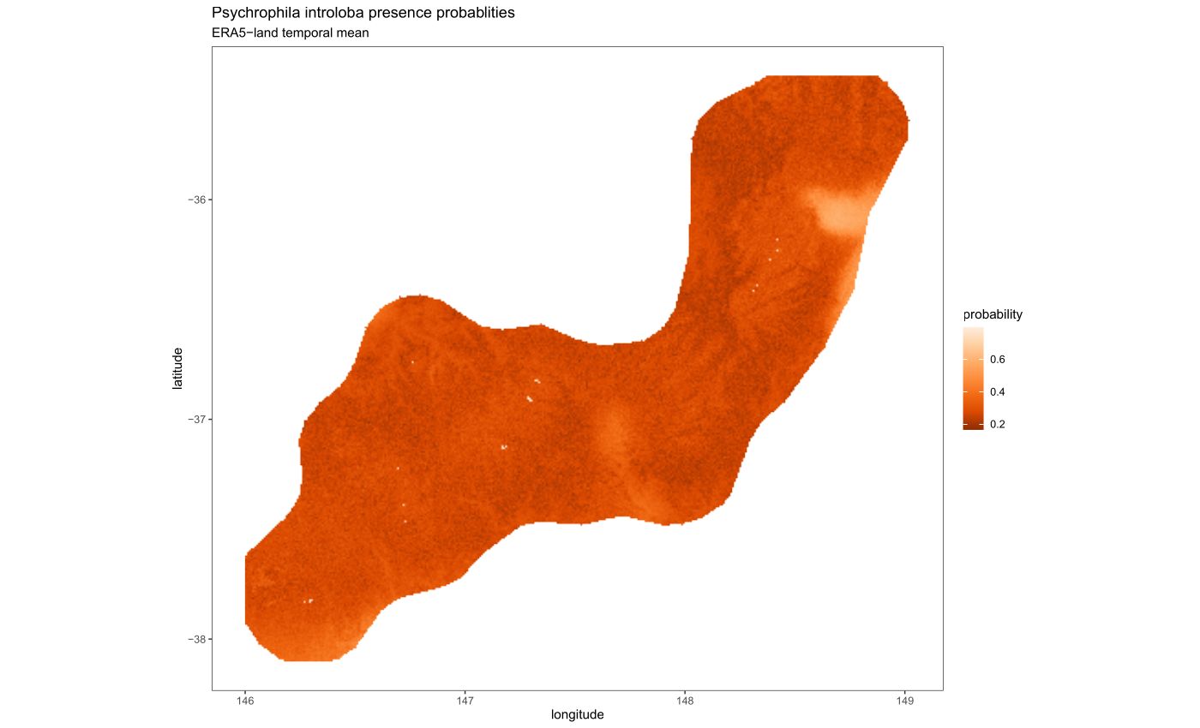
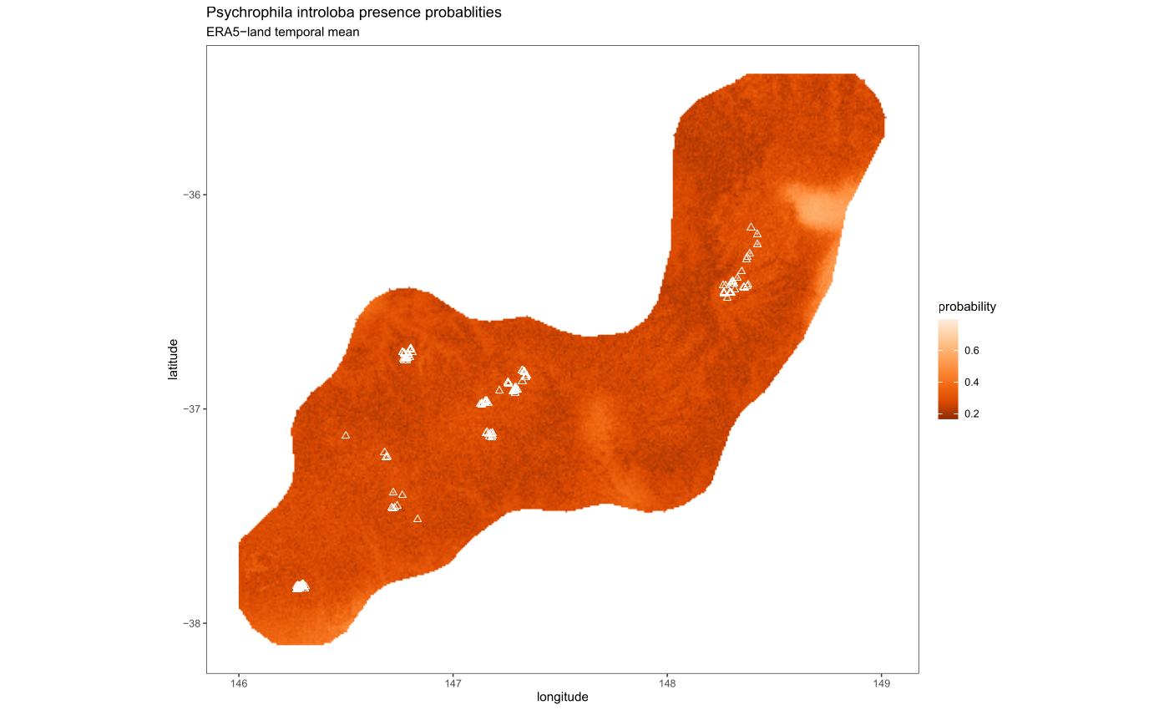
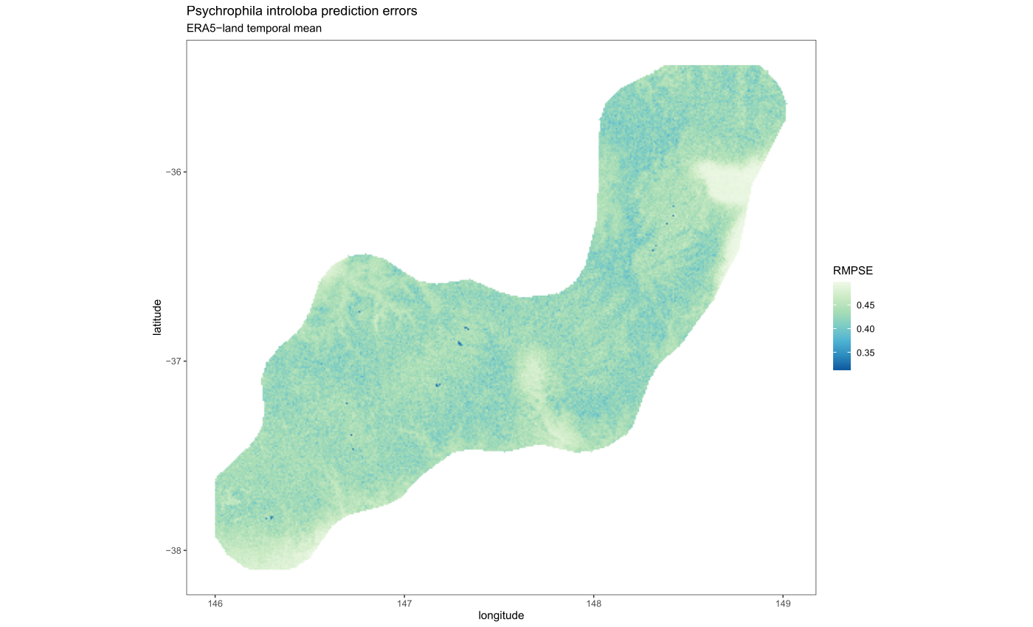

BIC : 190.7

Slide 39
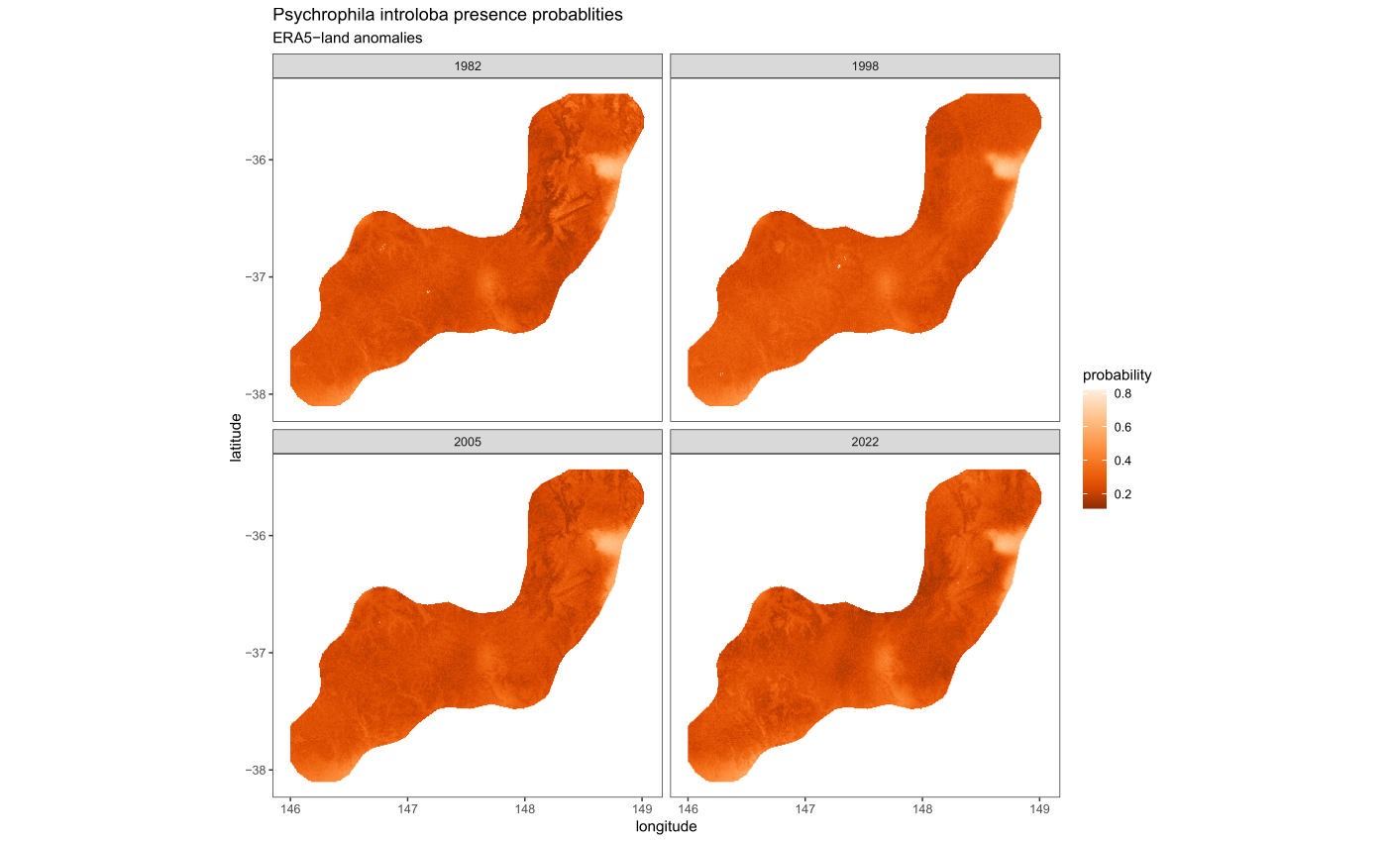
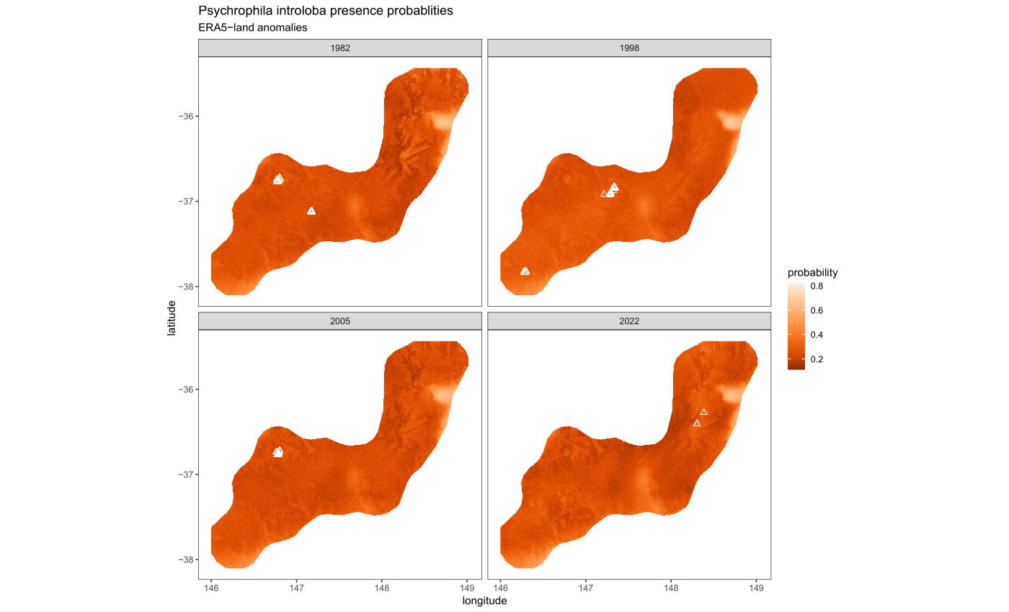
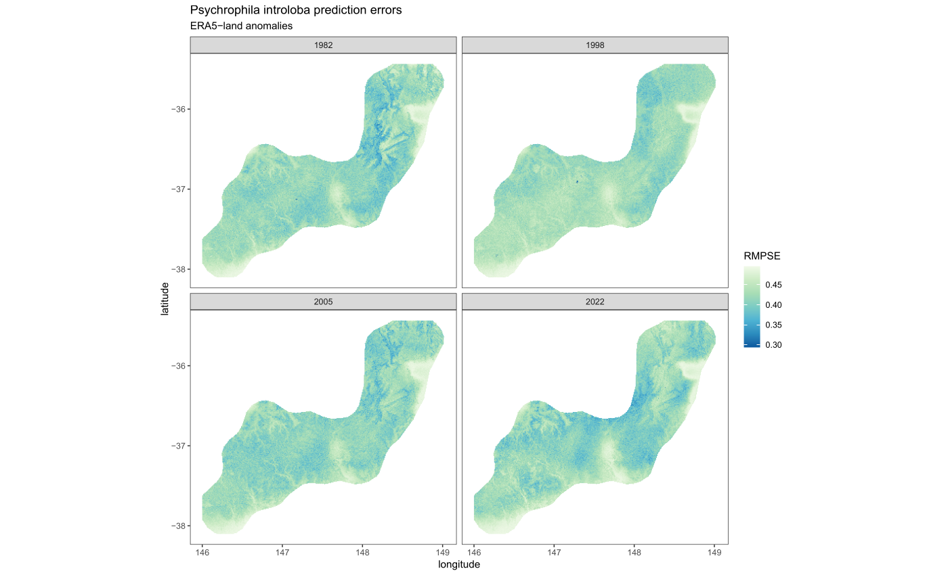
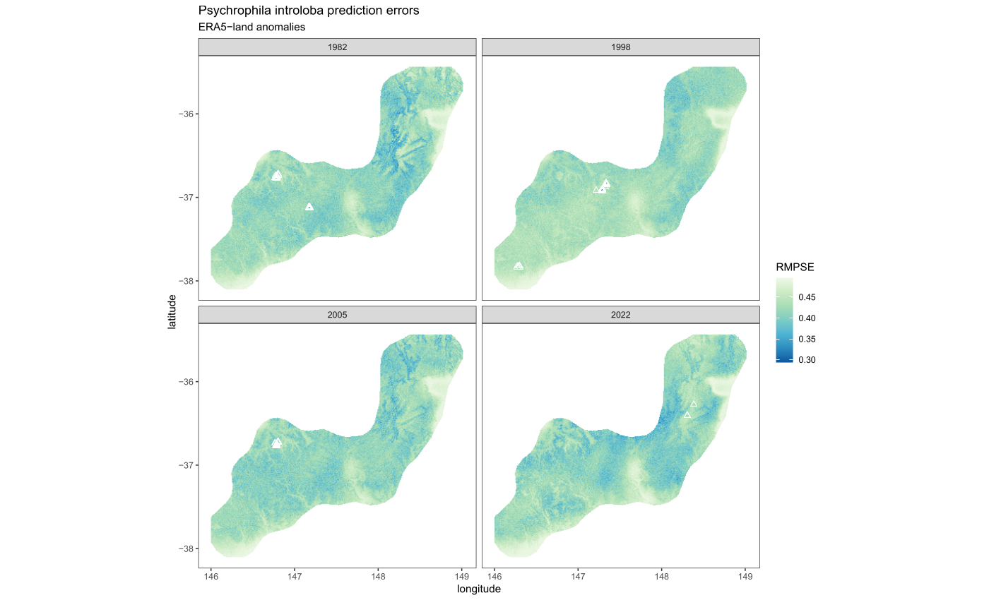
BIC : 403.4

Slide 40
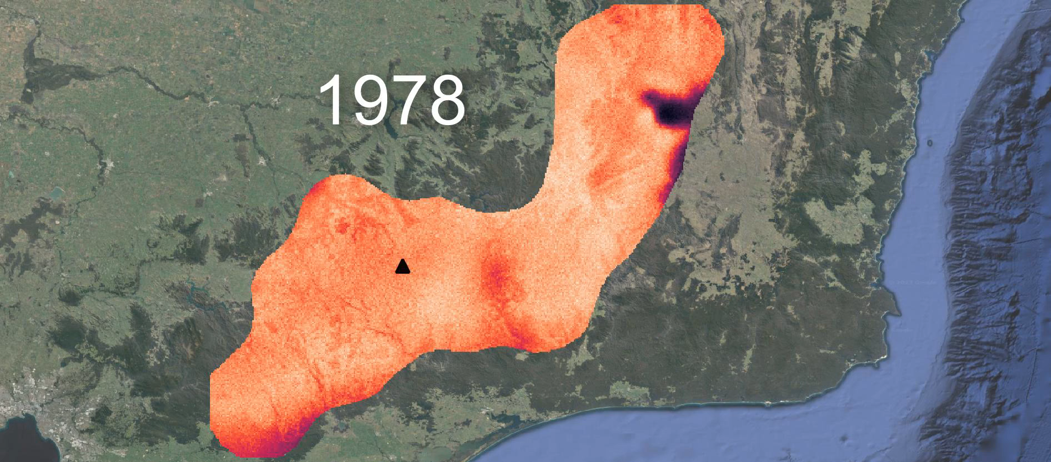
ERA5 anomaly model predictions 1978-2022

Slide 41
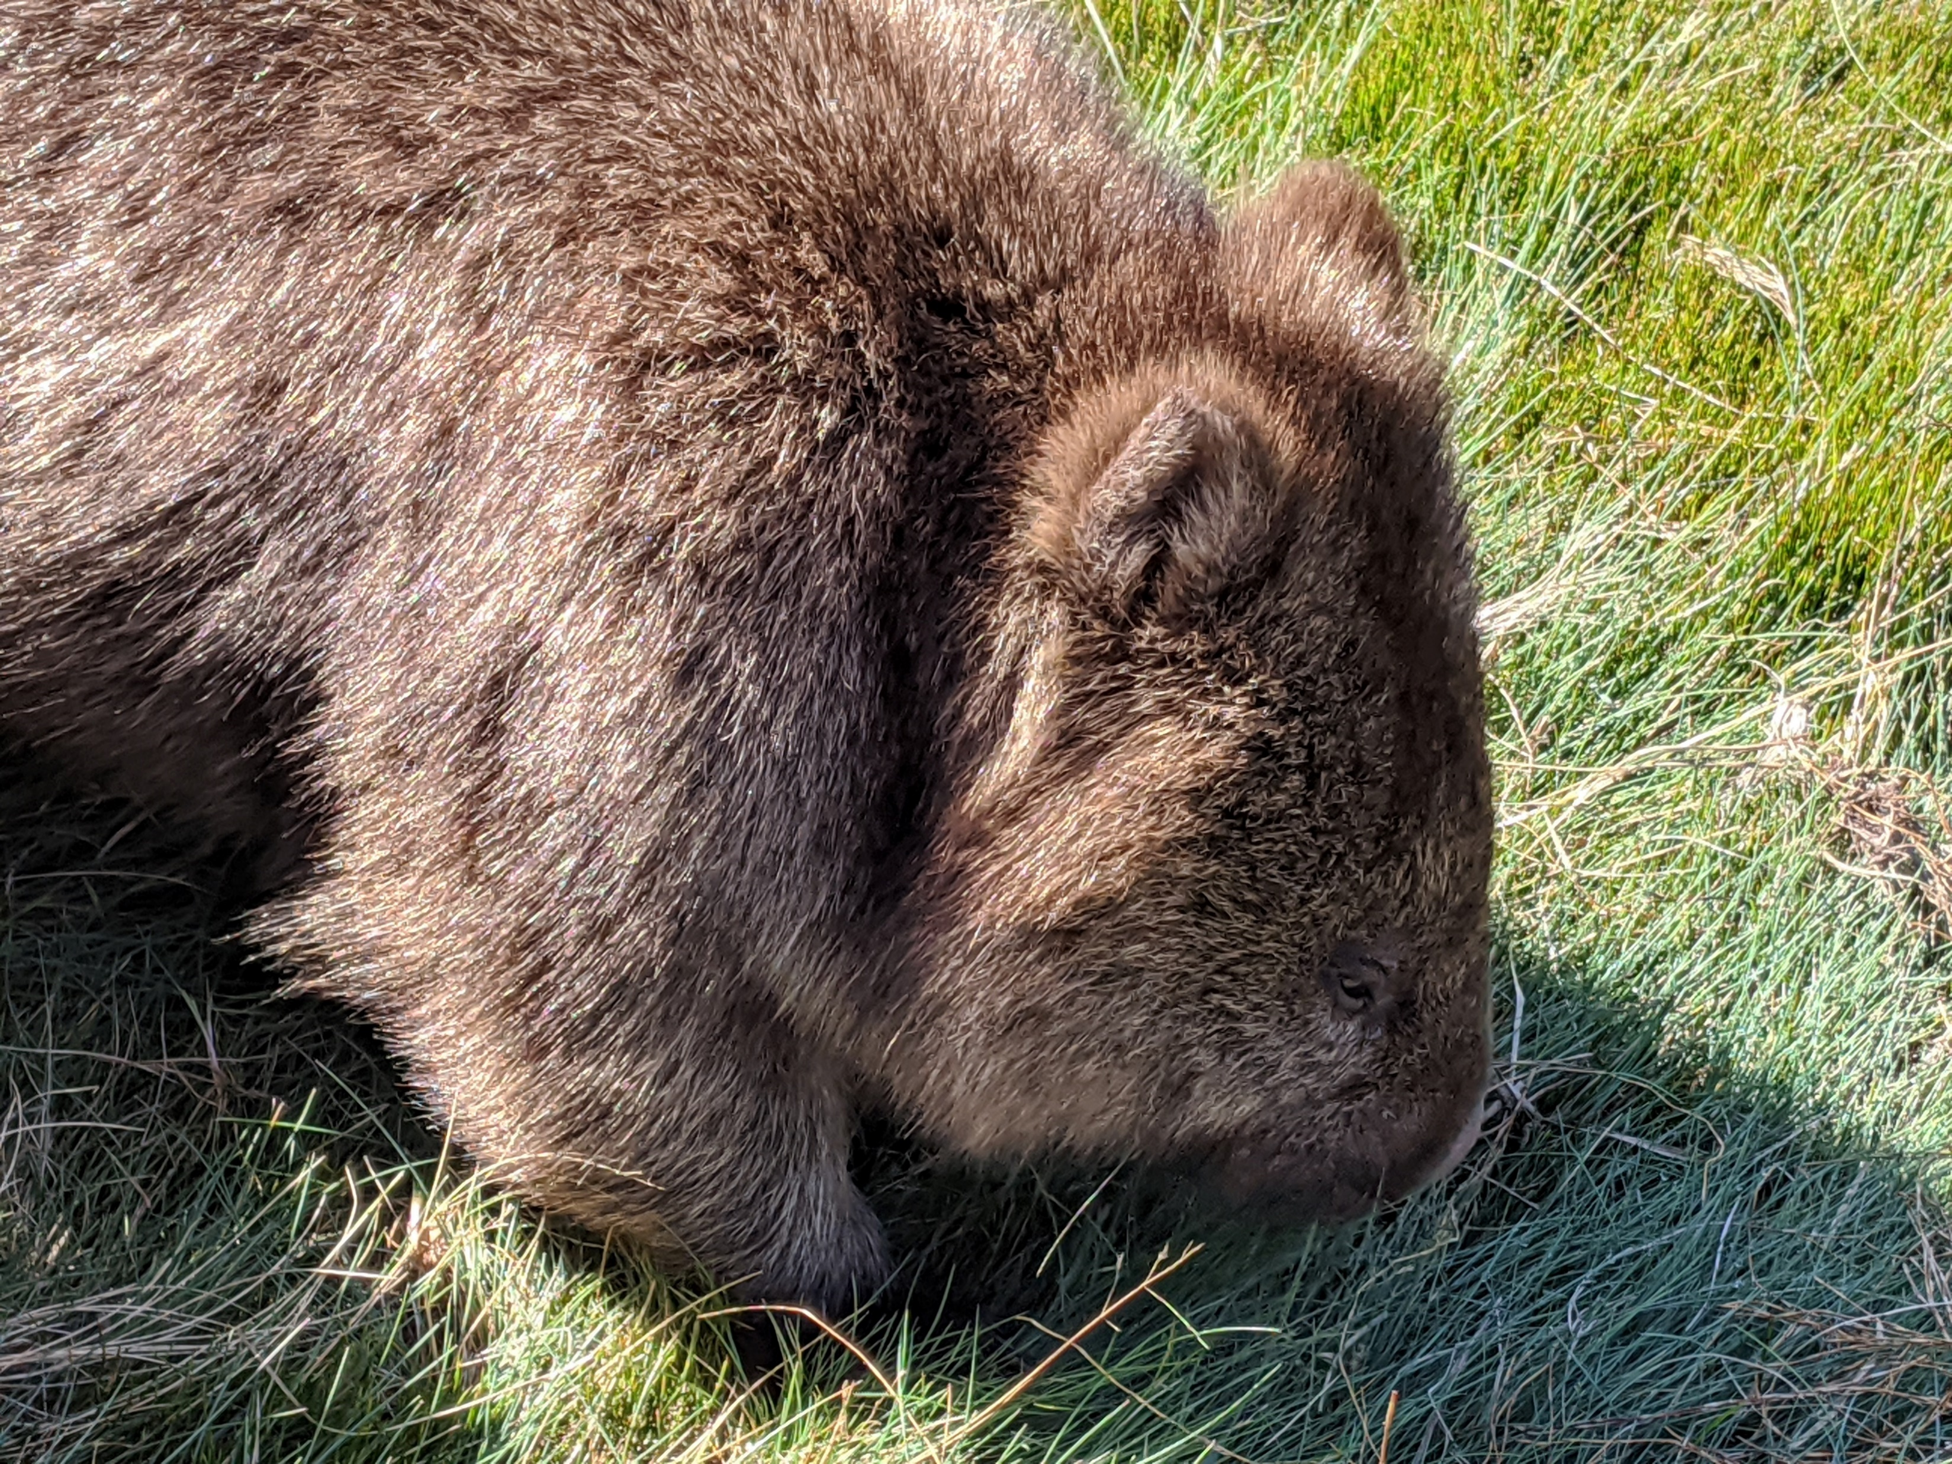
WHERE TO FROM HERE?

Slide 42
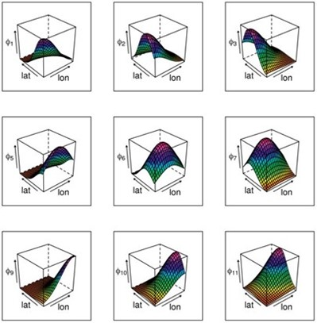
Next things to look at…
Expand modelling approaches/packages and basis functions (especially w.r.t time)
Assemble a variety of species datasets – both presence/absence and presence-only (a few dozen)
Notes:
There is also a need for an interactive approach to visualisation & exploration of ecological datasets

Slide 43
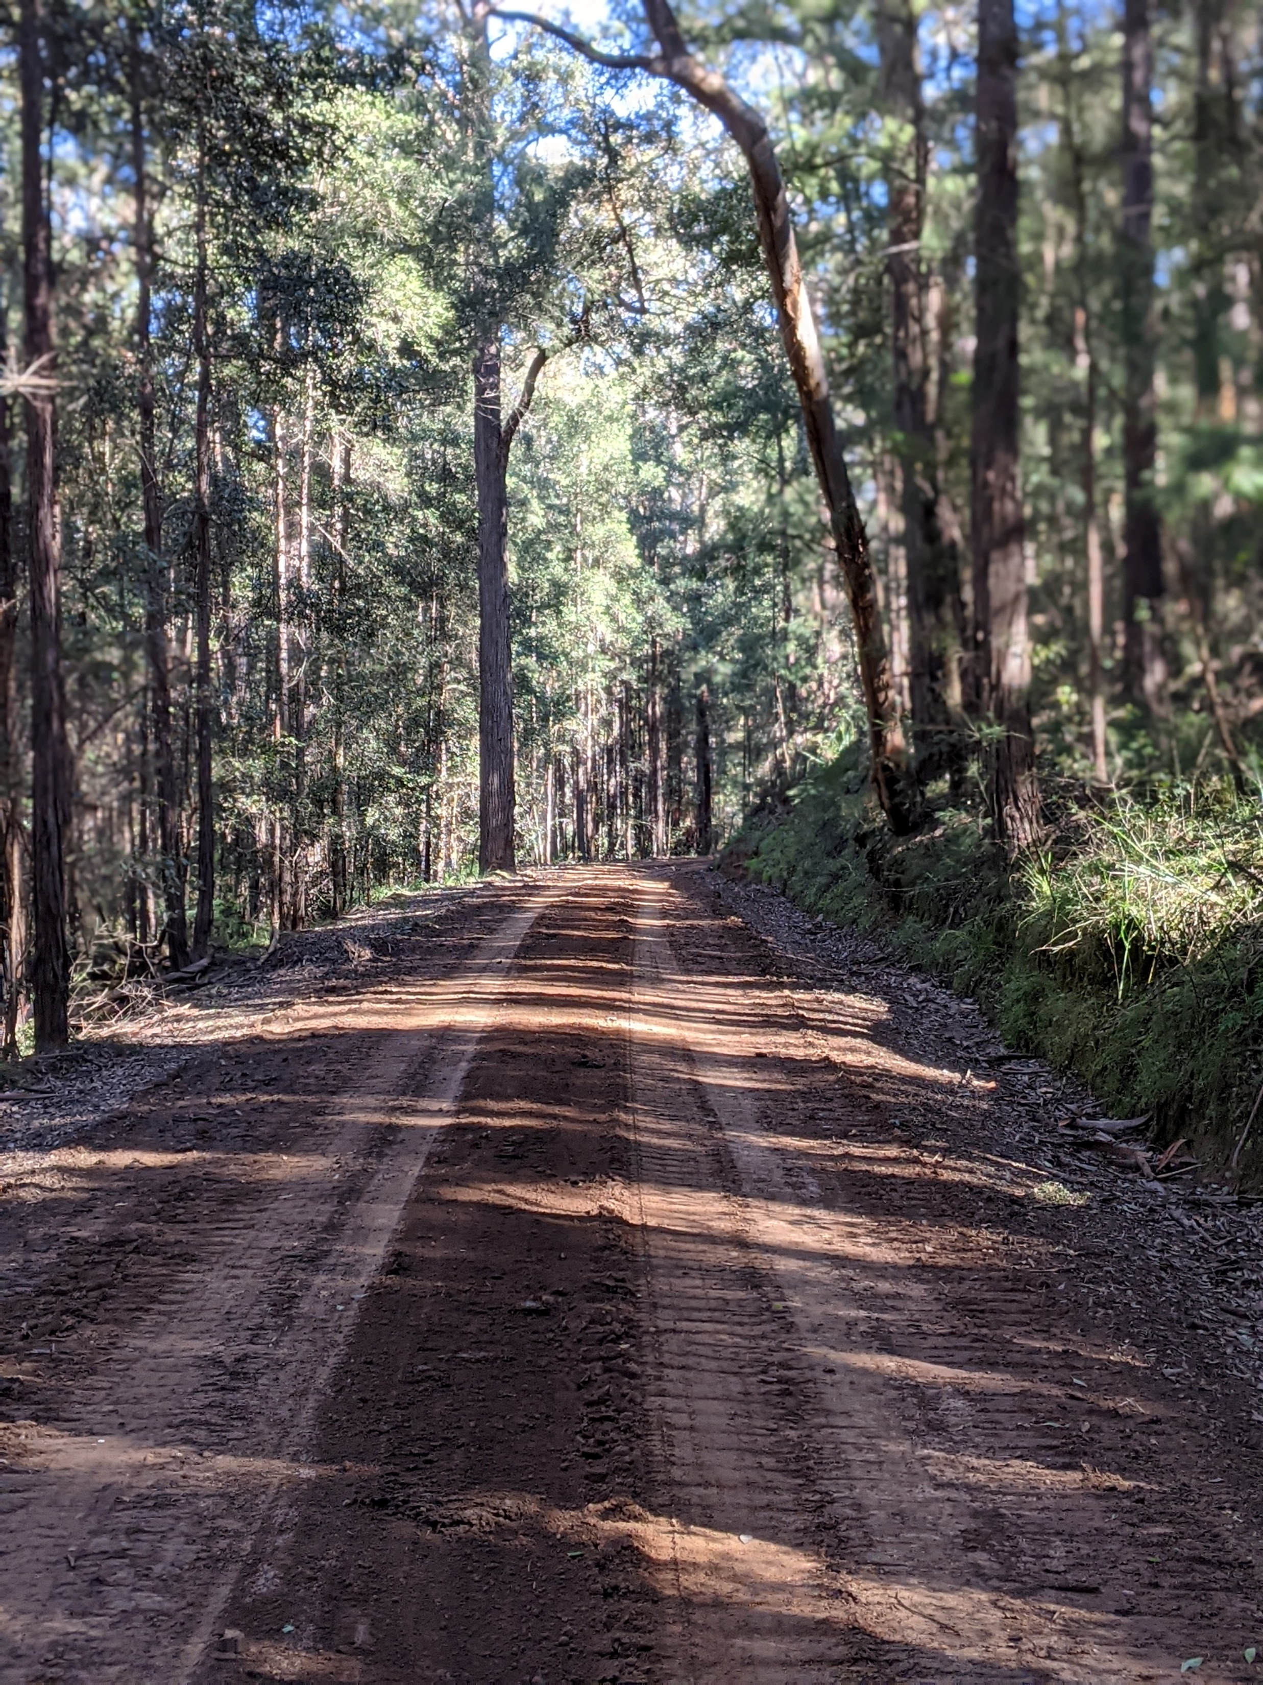
Next things to look at…
Scale up in time & space (if we can locate enough data!)
Spatio-temporal models that include various sources of uncertainty
Develop an interactive approach for the visualisation & exploration of ecological datasets

Slide 44

Acknowledgements
This research was undertaken on land traditionally owned by the Bedegal and Darkinjung people, who I would like to acknowledge and pay my respect to, as well as to Aboriginal Elders, past, present and emerging
UNSW School of Mathematics and Statistics
UNSW Eco-Stats Research Group
Support from government bodies including NSW Department of Planning & Environment, Victorian Biodiversity Atlas, Terrestrial Ecosystem Research Network
Erik Kusch, University of Oslo

Slide 45

QUESTIONS

